Slide 1


Satellite Image Processing
H Shiva Kumar
hs.kumar-p@incois.gov.in
ITCOOcean Training Program
on
“Coastal Vulnerability Mapping and Analysis using QGIS”
Organized by
International Training Center for Operational Oceanography (ITCOO)
INCOIS, Hyderabad, India
Nov 25 – 29, 2024

Slide 2

Outline
Satellite image downloading
Raster data opening in QGIS
Data conversion DN to Reflectance
Raster Band Composition
Change the band combination
Adding data to the band set
Data Clipping
Create the training input file
Training sample extraction
Image classification

Slide 3
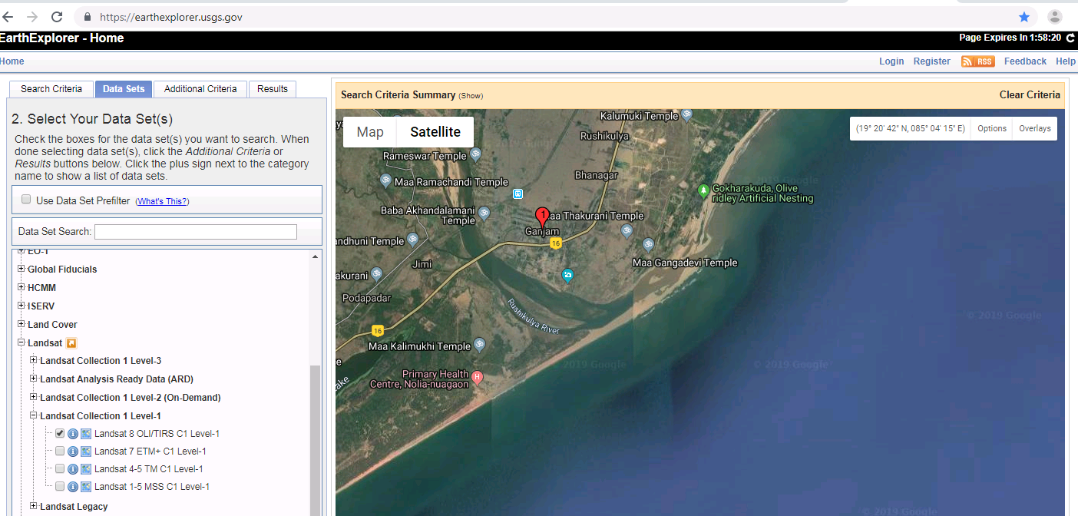
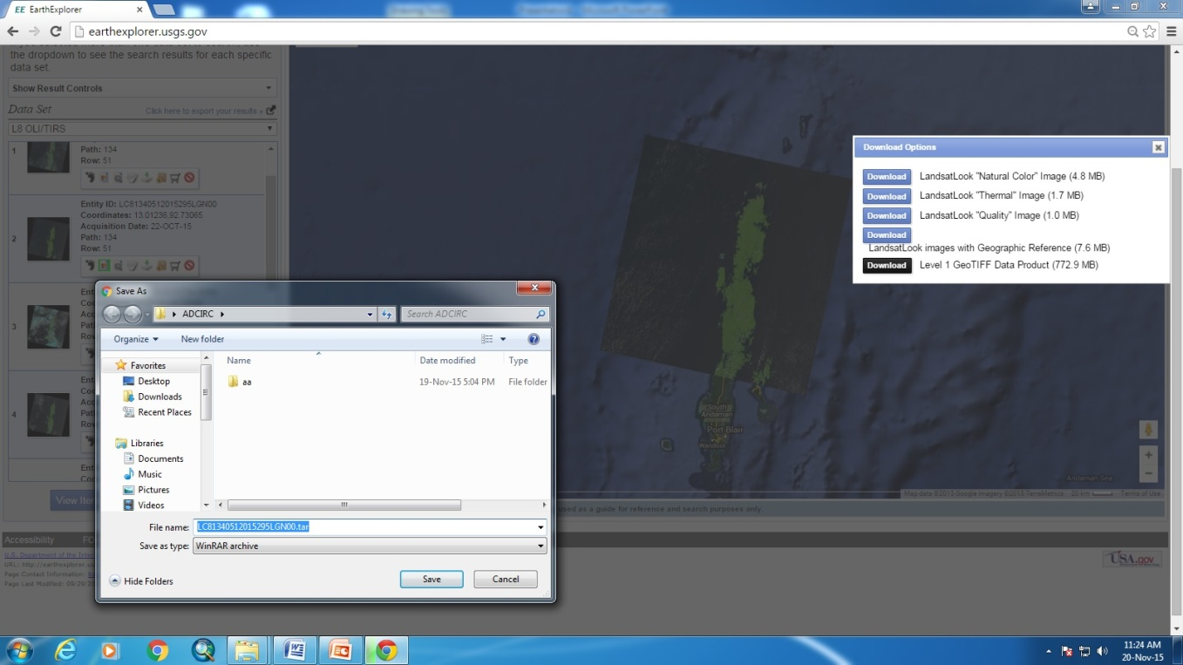
Satellite image Download (Landsat data)
Go to http://earthexplorer.usgs.gov/ and create new user account Login
3
4
7
2
1
5
6
8
Give the path to save data and click on save
Select clear and cloud free data
Download Landsat 8 OLI Level-1 product data set
After download unzip/uncompress the file

Slide 4
Landsat 9 OLI bands
Band | Wavelength | Spatial Resolution | Useful for mapping
Band 1 - coastal aerosol | 0.43-0.45 | 30 | Coastal and aerosol studies
Band 2 - blue | 0.45-0.51 | 30 | Bathymetric mapping, distinguishing soil from vegetation and deciduous from coniferous vegetation
Band 3 - green | 0.53-0.59 | 30 | Emphasizes peak vegetation, which is useful for assessing plant vigor
Band 4 - red | 0.64-0.67 | 30 | Discriminates vegetation slopes
Band 5 - Near Infrared (NIR) | 0.85-0.88 | 30 | Emphasizes biomass content and shorelines
Band 6 - Short-wave Infrared (SWIR) 1 | 1.57-1.65 | 30 | Discriminates moisture content of soil and vegetation; penetrates thin clouds
Band 7 - Short-wave Infrared (SWIR) 2 | 2.11-2.29 | 30 | Improved moisture content of soil and vegetation; penetrates thin clouds
Band 8 - Panchromatic | 0.50-0.68 | 15 | Sharper image definition
Band 9 - Cirrus | 1.36-1.38 | 30 | Improved detection of cirrus cloud contamination
Band 10 - TIRS 1 | 10.60-11.19 | 100 | Thermal mapping and estimated soil moisture
Band 11 - TIRS 2 | 11.50-12.51 | 100 | Improved thermal mapping and estimated soil moisture
Open layer data adding to QGIS:

Slide 5
SemiAutomaticClassification (SCP) plugin installation
Download SCP version 7.10.11
https://plugins.qgis.org/plugins/SemiAutomaticClassificationPlugin/version/7.10.11/
Go to plugins --. Manage and install plugins → install from zip → browse SCP version 7.10.11 → install plugin.
If SCP does not work properly- Troubleshoot:
download the SCP zip archive from https://github.com/semiautomaticgit/SemiAutomaticClassificationPlugin/archive/master.zip ;
extract the content of the archive (several files such as COPYING.txt and folders such as ui) in a new folder named SemiAutomaticClassificationPlugin (without -master);
open the QGIS plugins directory (in Windows usually C:\Users\username\AppData\Roaming\QGIS\QGIS3\profiles\default\python\plugins, in Linux and Mac usually /home/username/.local/share/QGIS/QGIS3/profiles/default/python/plugins) and delete the folder SemiAutomaticClassificationPlugin if present;
copy the folder SemiAutomaticClassificationPlugin inside the QGIS plugins directory;
the plugin should be installed; start QGIS, open the Plugin Manager and be sure that Semi-Automatic Classification Plugin is checked.
Open QGIS go to plugins → Manage and install plugins → settings → click on add →Name: SCP → URL: https://semiautomaticgit.github.io/SemiAutomaticClassificationPlugin_v7/repository.xml → ok → click on all → select Semi-Automatic Classification plugin- master → click on install.
Windows plugin path Ex: C:\Users\Administrator\AppData\Roaming\QGIS\QGIS3\profiles\default\python\plugins
Useful link: https://semiautomaticclassificationmanual.readthedocs.io/en/latest/faq.html?fbclid=IwAR1GipLN96SreRlCG7XyCV47b6DithxMnFZJ7LSv69s-M7zV2If3MjoK-h0#how-can-i-report-an-error

Slide 6
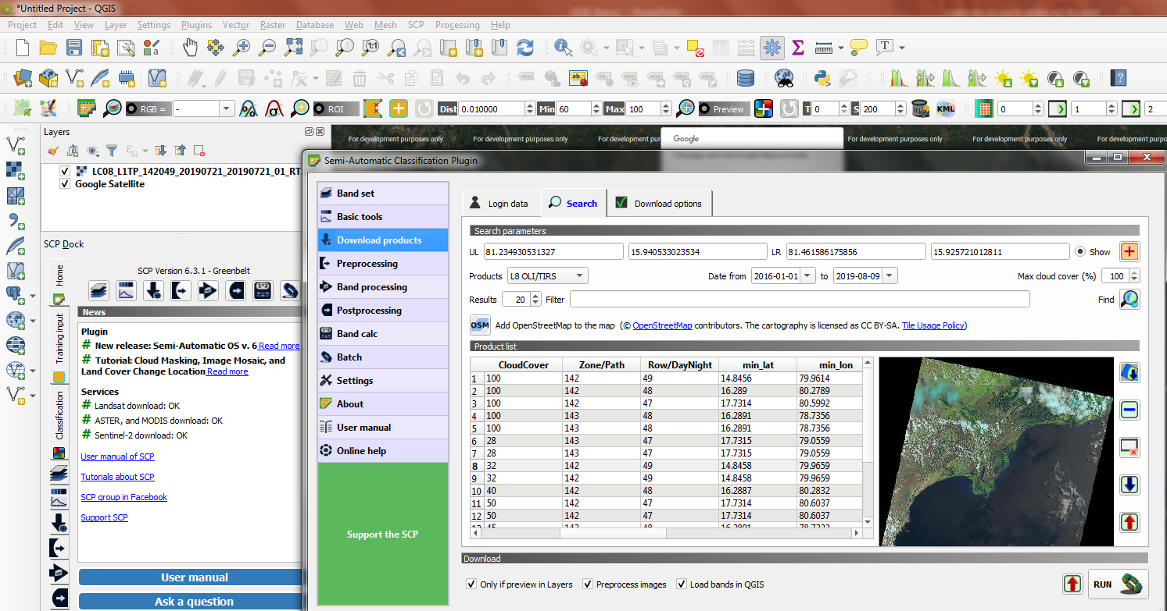
Raster data downloading in QGIS:
Now open Semi Automatic Classification Download Products
Click on login data enter login ID and Password (Need login in https://ers.cr.usgs.gov/login/)
Click on search clock on + symbol now go to QGIS window left click for UL, right click for UR
Now coordinates will appear in UL and UR Products select L8 OLI/TRS Select Date
Click on find image list will come select image Click on run give path to save data
1
3
4
2
5
6
7
8
9
10

Slide 7
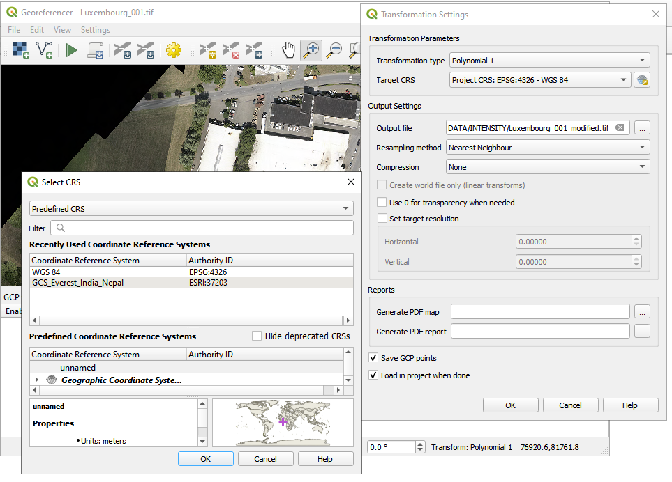
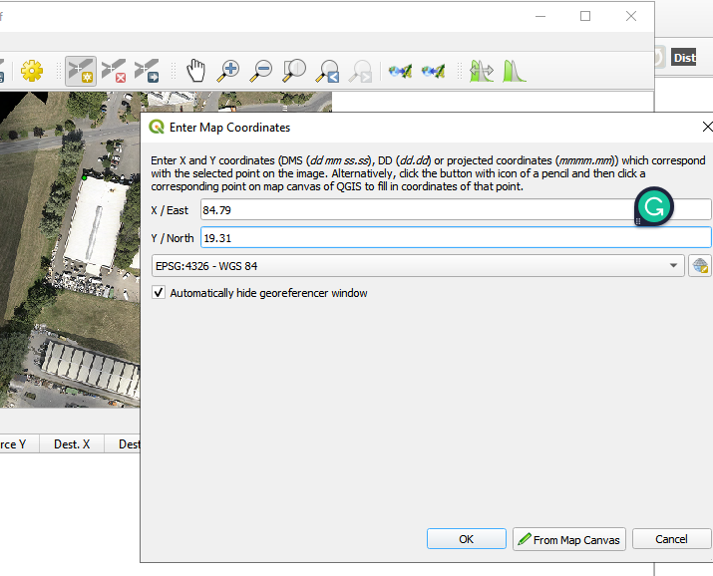
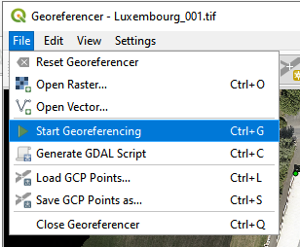
Toposheet/ Image georeferencing
Open QGIS → go to Layer → Georeferencer →Georeferencer window will open→ go to file →open raster →browse our unreferenced image/ toposheet.
Go to settings →Transformation Settings → Transformation type: select polynomial1→ Target CRS : click on it → custom CRS : select predefined CRS →select WGS84 → output file: give output location and file name→ resampling method : Nearest Neighbour → save GCP points→ ok
Click on add point → place point on toposheet/ image → enter lat and long values → ok → take 4 points
Click on save GPC points as→ give path and name → Now Go to the file and click on start geoferencing.
After Georeferenced open online data check using Map swipe tools
CRS polynomial order: https://docs.qgis.org/3.28/en/docs/user_manual/working_with_raster/georeferencer.html

Slide 8
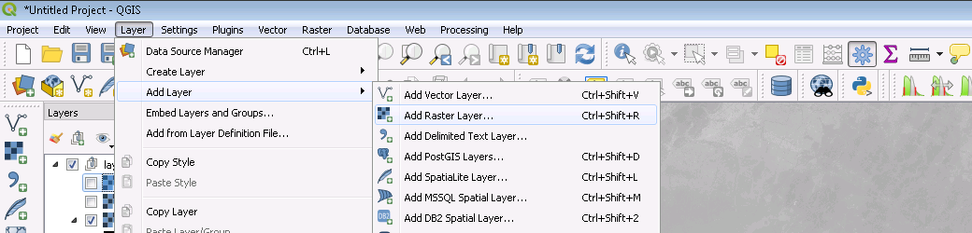
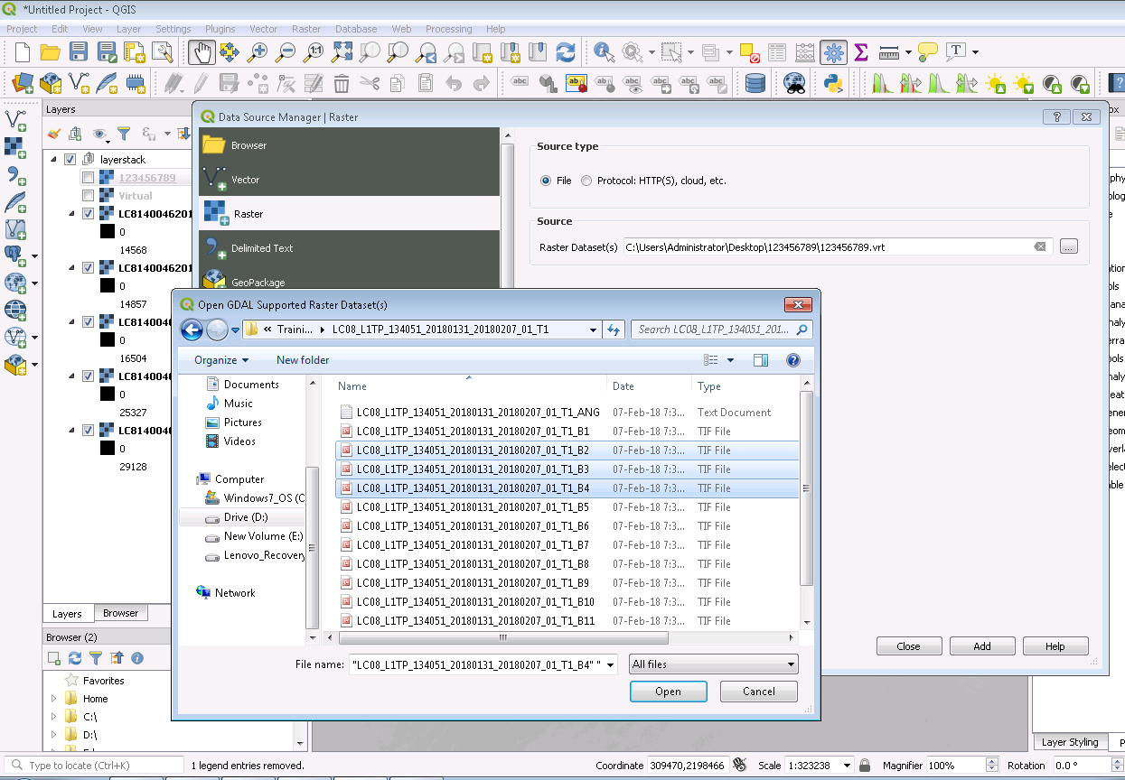
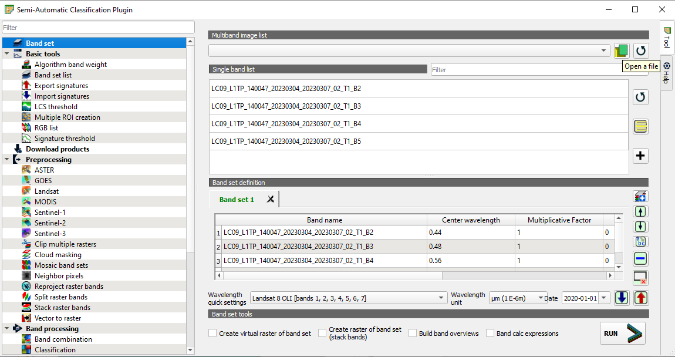
Raster data opening in QGIS:
Method 01
Method 02
1
Go to SCP tool → Band set, → click on Open a file →
browse and select bands → Open
Add bands to band set:
After the above step → click on select all bands →click on
Add band to band set.
2
3
4
a
b
c
d
5
6

Slide 9
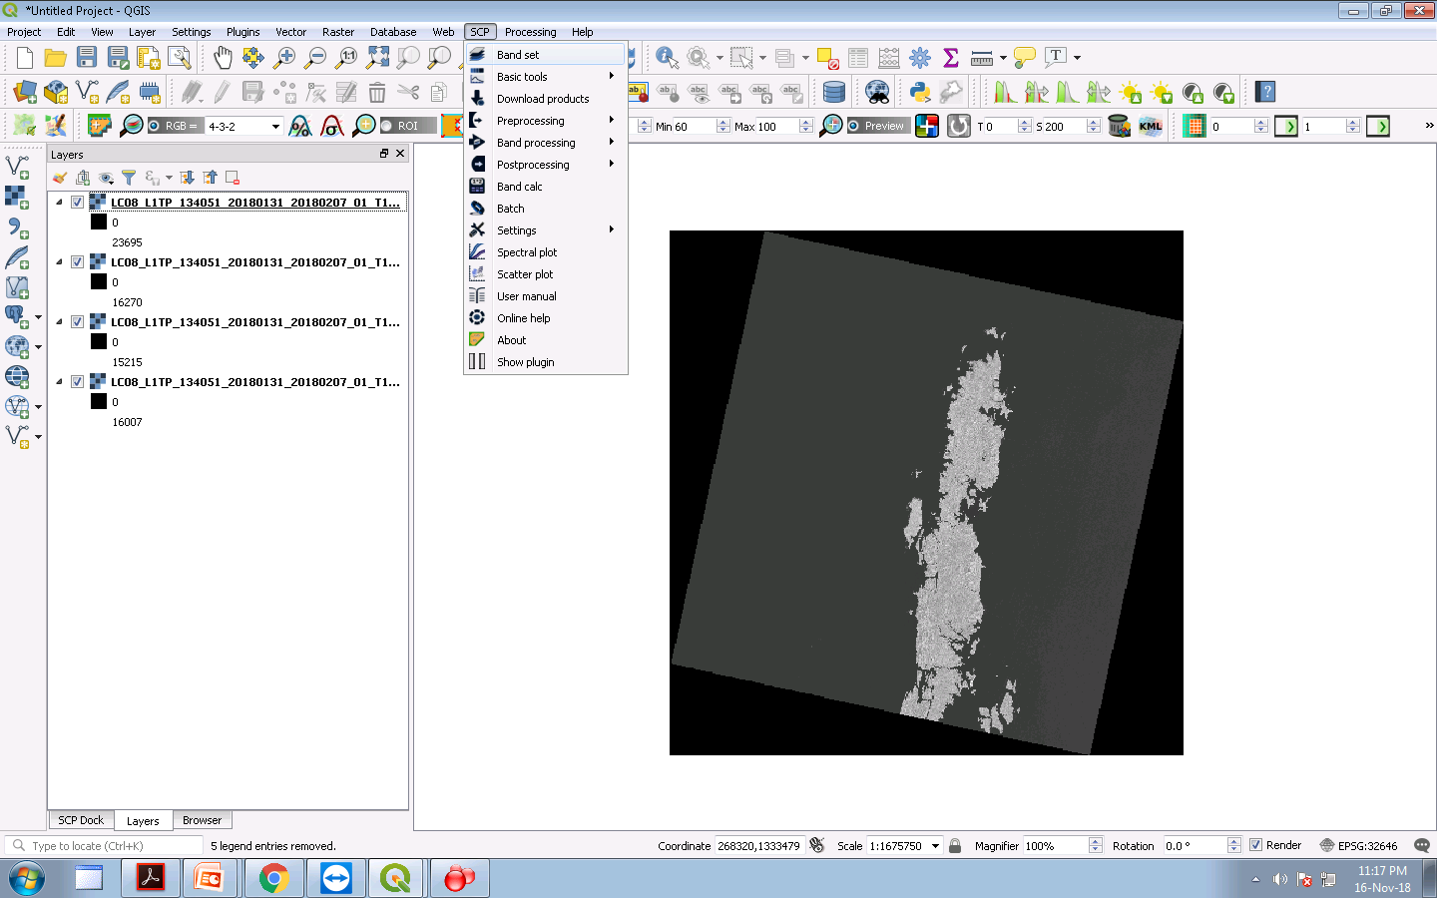
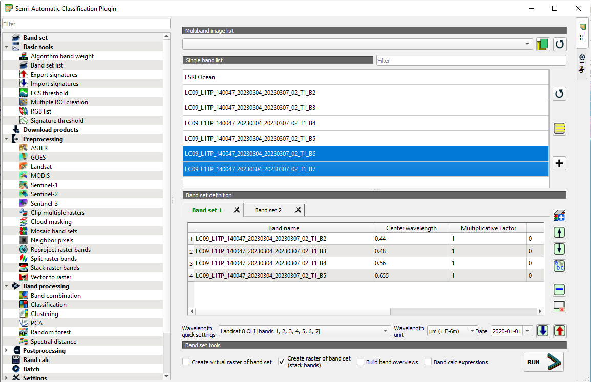
Adding data to multiple band sets:
Go to SCP click on band set SCP plugin window opens.
1
2
In the last slide, one band set is created
If we want to create more band sets and
Add different bands to them.
Create new band set and add bands:
Clock on add a new band set→ and select
that new band to Add bands to that band set
→ select Bands and click on add bands
to band set.
Add or remove bands from the band set:
select bands in the band set to remove
For that band, click on the delete row.
To remove all bands from band set→ click
on reset.
Select band set and select bands in single
band and click on add bands to band set.
If band data not added to QGIS window click on open file Browse the image file
3
4
3
4
Now select the bands which you want
to create band set or select all bands
5
2
1
5
6
6
7
8

Slide 10
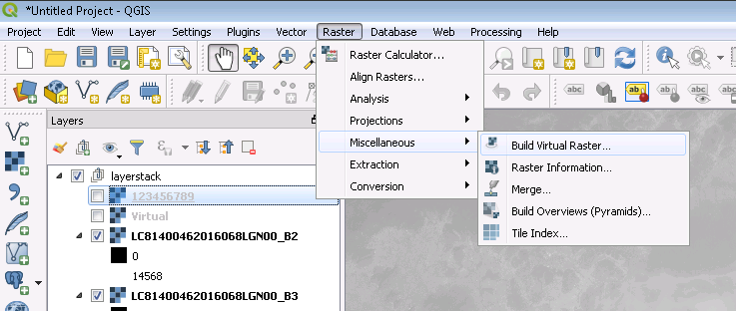
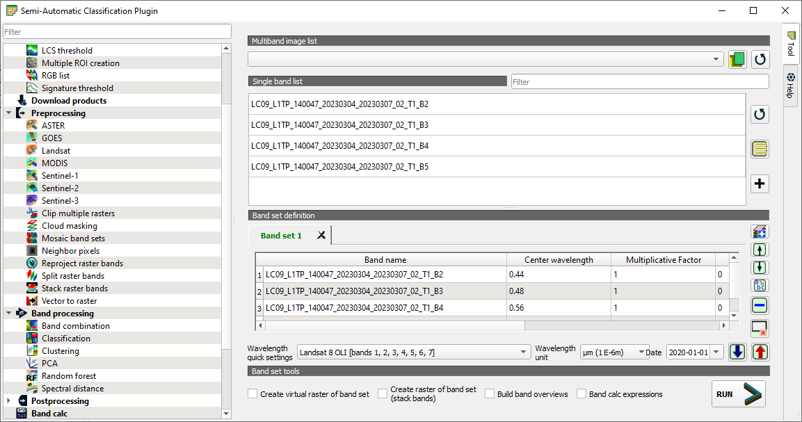
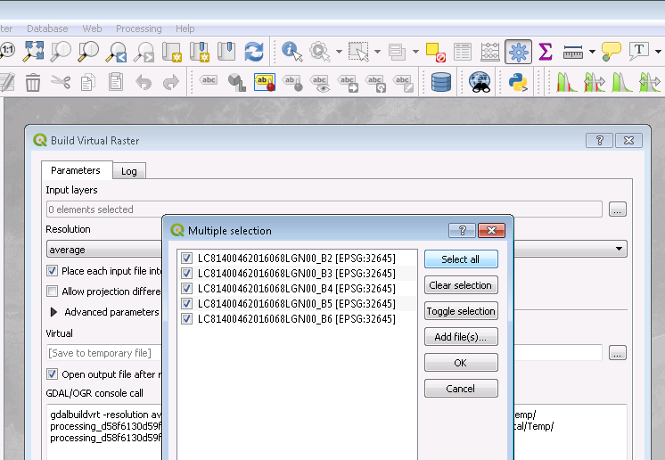
Raster Band Composition/ Layerstack:
Method -01
Method -02
1
Go to SCP tools → bands are added to band set →click on create
raster of band set (stack bands) → click on run → give output folder
or
Go to Preprocessing →Stack Raster Bands→ Select bands set →Run →
Give path and name.
2
3
4
5
6
Go to Raster Miscellaneous → Build Virtual Raster →Input layers, select
our bands →go to Virtual→ save file → give the name and path → run

Slide 11
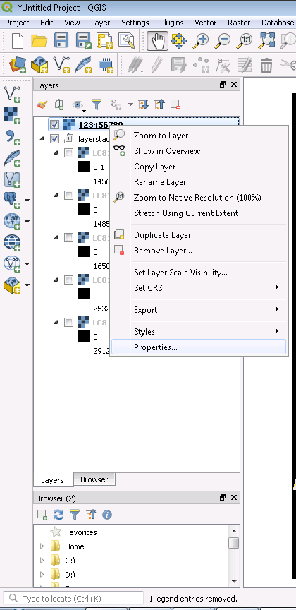
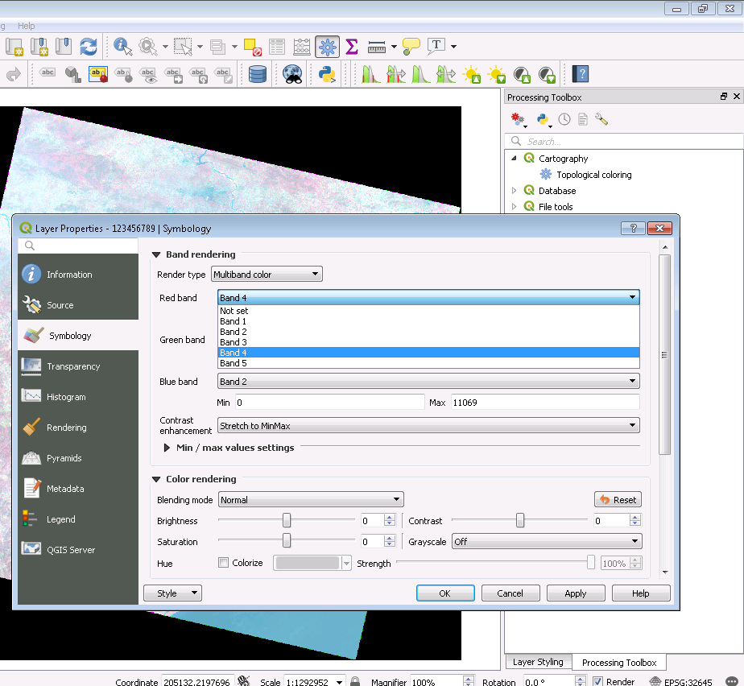
Change the band combination
Select the FCC image right click properties
1
4
3
2
6
5

Slide 12
DN to Reflectance Conversion
Conversion to TOA Reflectance
Reflective band DN’s can be converted to TOA reflectance using the rescaling coefficients in the MTL file:
ρλ′=MρQcal+Aρ
where:
ρλ' = TOA planetary reflectance, without correction for solar angle.
Note that ρλ' does not contain a correction for the sun angle.
Mρ=Band-specific multiplicative rescaling factor from the metadata (REFLECTANCE_MULT_BAND_x,
where x is the band number)
Aρ =Band-specific additive rescaling factor from the metadata (REFLECTANCE_ADD_BAND_x,
where x is the band number)
Qcal = Quantized and calibrated standard product pixel values (DN)
https://yceo.yale.edu/how-convert-landsat-dns-top-atmosphere-toa-reflectance
https://www.usgs.gov/landsat-missions/using-usgs-landsat-level-1-data-product

Slide 13
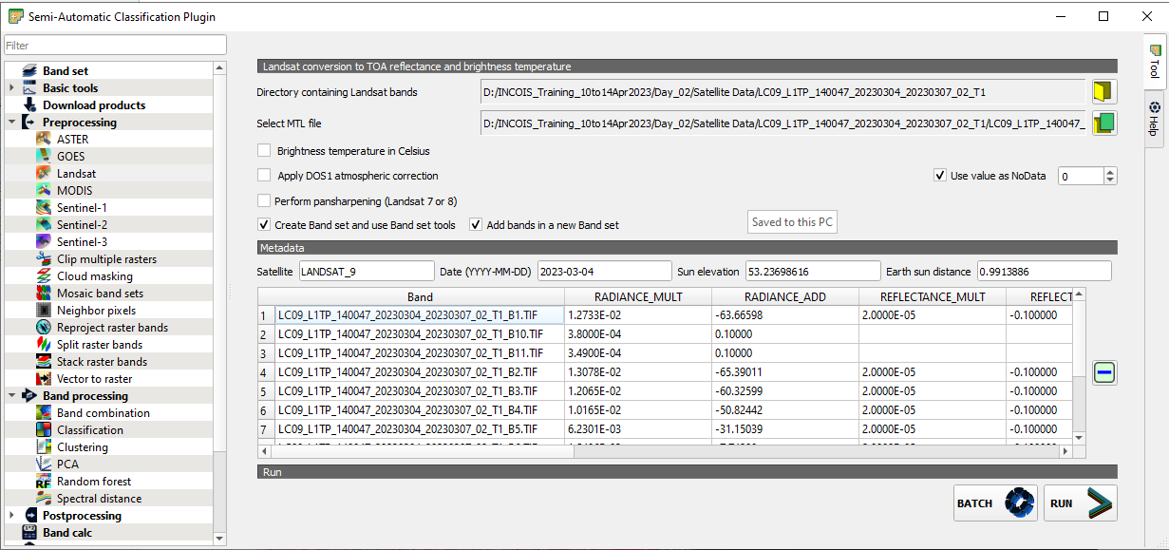
Data Conversion
Method:01 Go to SCP → creates a band set
Go to Preprocessing, → click on Landsat(select based on your satellite data) → click on select directory → browse our satellite data stored folder → click on Open a file: give metadata file → check create band set and use band set tools , add bands in a new band set. → run → give output folder.

Slide 14
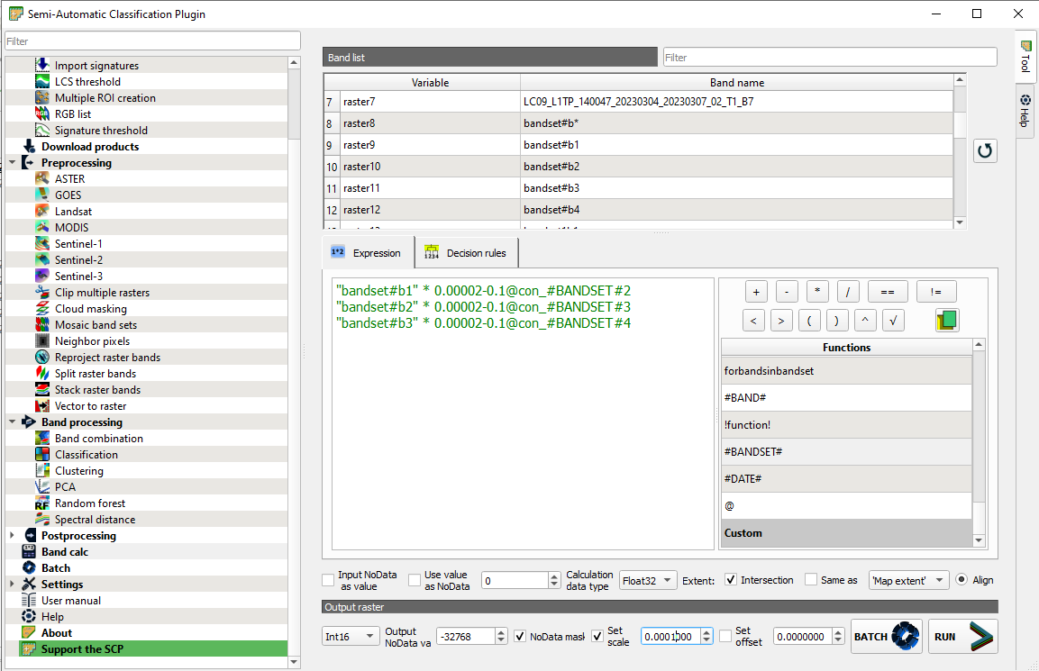
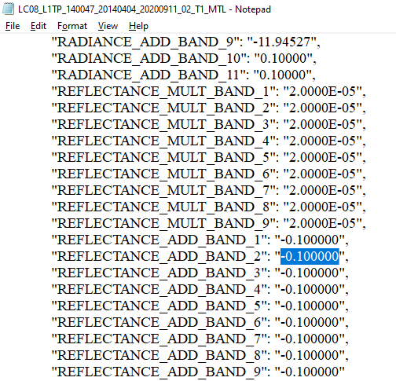
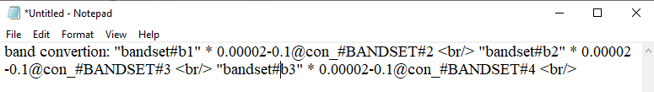
Continue……
Method:02 Go to SCP → Bandcalc → write formula → run → output folder name.
To save the formula → open Notepad →copy and paste the formulas → separate with <br/>, and save→ click on open text file → browse our file →open.
In custom, we can see our file → if you double click on file equations will load → and run
To compress the size of the output image:
in the output raster → select int16 and set scale: 0.0001→ Run → give output path.

Slide 15
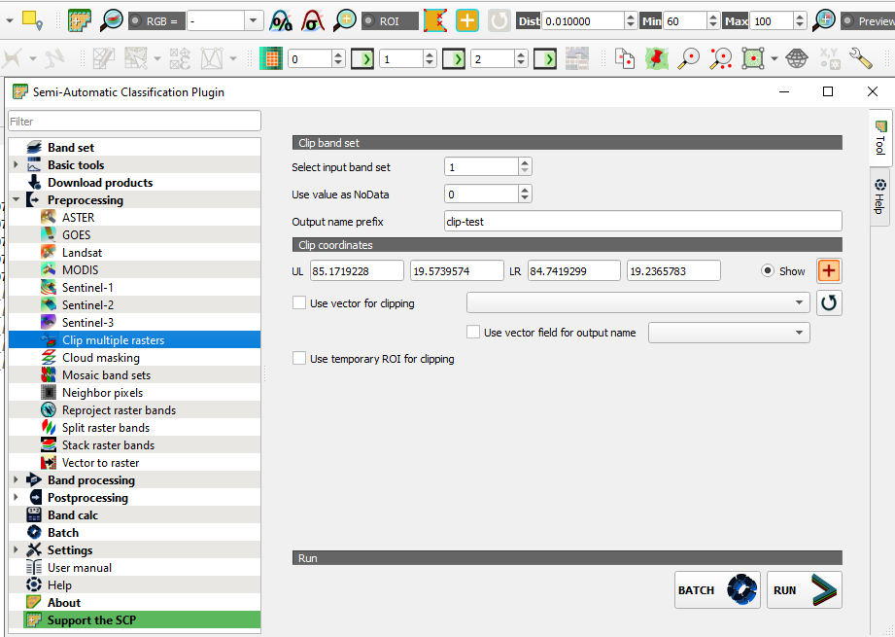
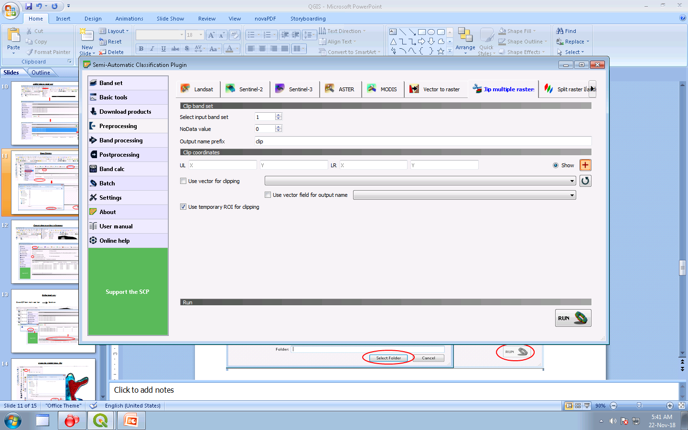
Image Clipping
Go to SCP → preprocessing →Clip multiple rasters → Select band set → Use value as no data: 0 → O/P name: give any name →to select RIO click on set an area in the map, → put points on the map, → click on the run → give output folder name.
Select ROI using a vector file:
If you have an ROI vector file we can use that file to clip the raster image → open the vector file in map window →just check the use vector for clipping: select our vector file → and run give o/p path.
Select ROI using temporary ROI:
Using the ROI tool in the map window draw ROI on the map/ image. Now in SCP Check use temporary ROI for clipping→ run → give output path.
2
3
5
1
6

Slide 16
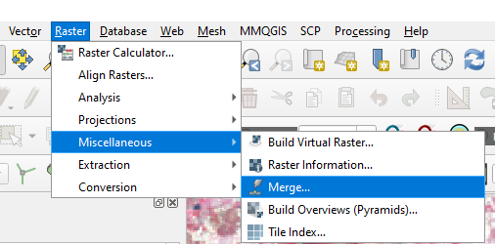
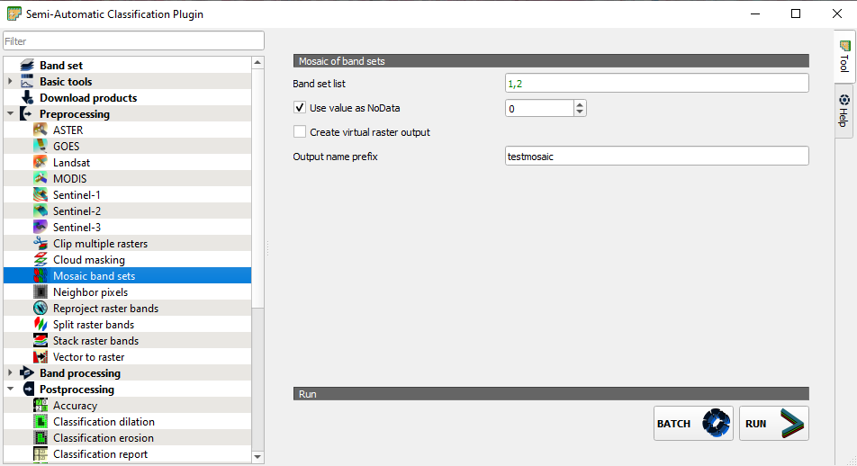
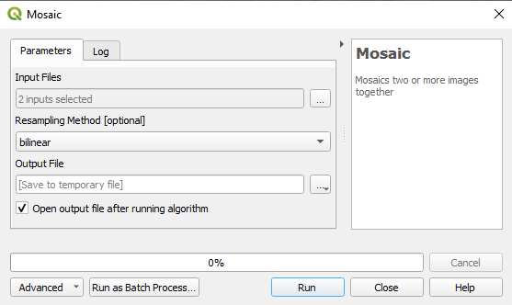
Image mosaicking
Method 01
Method 02
Go to SCP →band set → open files (open two scenes files) →Add one scene band to band set 1 and the second scene to band set 2
Go to Preprocessing → mosaic band sets → band set list: enter band set numbers (ex:1,2) →output name prefix: give name → run → give output path.
Go to Raster → Miscellaneous →Merge→ give →parameters → input layers: select our single or fcc images →merged: give output path and file name.
Method 03
Go to white box tools →Image processing tools →Mosaic → Input files: select our files → resampling method: select method (ex: bilinear) → output file: give the path and file name → run

Slide 17

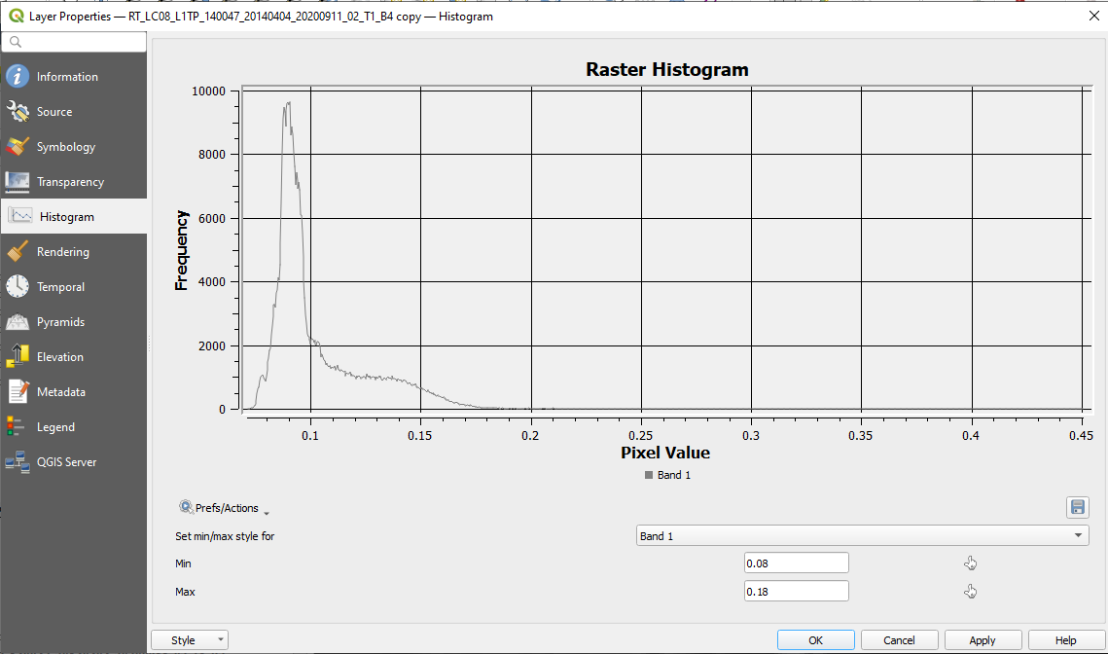
Image enhancement (Histogram Equalization)
Right on the main menu → check the Raster Tool bar → select the image in the Layer panel and click on Local histogram stretch. Now we can see the change in the image appearance.
We can use min max values to change the image appearance:
Select Image in the Layers panel → Right click go to the properties → Layer properties window will open. Now click on Histogram → click on Compute Histogram → now adjust the min and max values → ok.
Or instead of the histogram click on symbology and change min max values → ok.

Slide 18
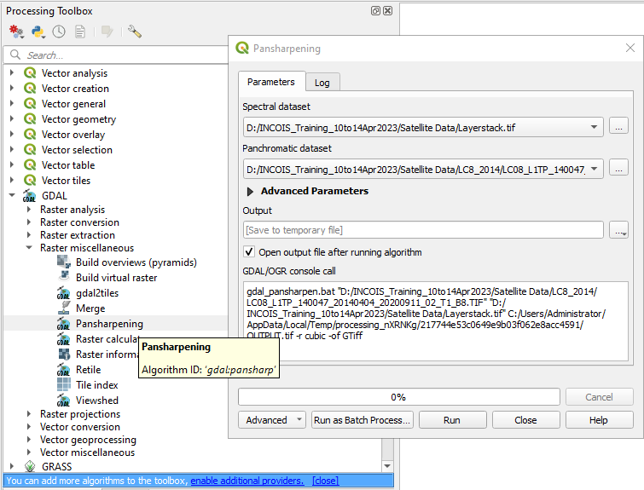
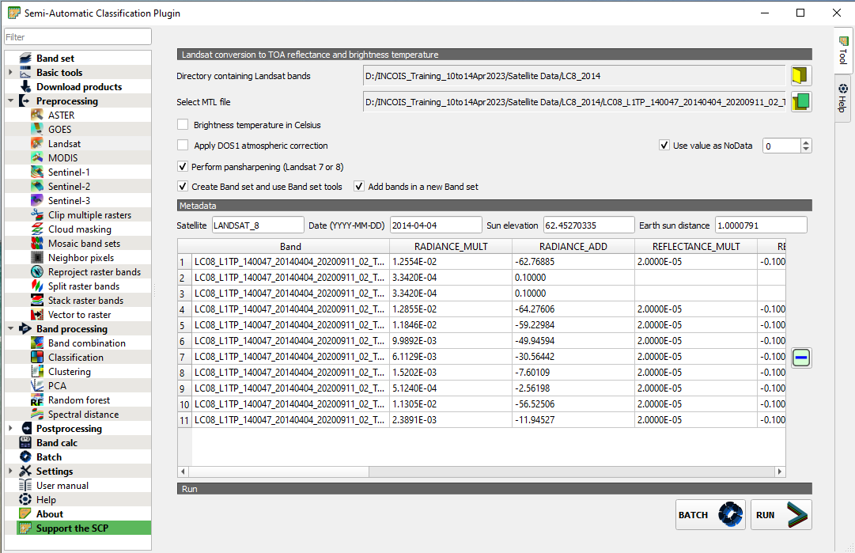
Image resampling / Resolution merging
Method 01:
Using GDAL pan-sharpening
Go to Processing ToolBox→ GDAL
Method 02:
Go to SCP →Preprocessing→ Landsat → Give the data folder and MTL file path→ check Perform the Pan sharpening →Run → and give the output path name.
3
4
1
5
2
6
Method 03:
Go to Processing ToolBox →WhiteBox Tool→ Image processing → Resample → Give the input data (Multi-Spectral Image) → Select Base-layer (Pan image)→Select resampling method → give the output path and name →Run.

Slide 19
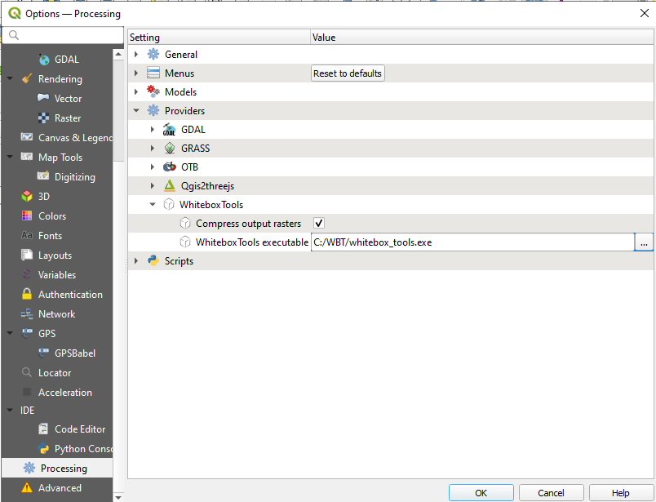
WhiteBoxTools Installation
Go to Plugins → Manage and install plugins → go to All → Search WhiteBox Tools → select WBT→ click on install
Now, we can use white box tools, but before that, we have to configure executable file.
Go to the WhiteBox Tools website: https://www.whiteboxgeo.com/ → click on whiteboxTools open core (WbT)→ download → select $0 → download.
Unzip the Downloaded file → rename it to WBT and copy the folder and past in C: drive
Now go to QGIS → settings → options → process →providers and expand it → click on whitebox tools executable → Browse whitebox_tool.exe file (C:\WBT) → open → ok.

Slide 20
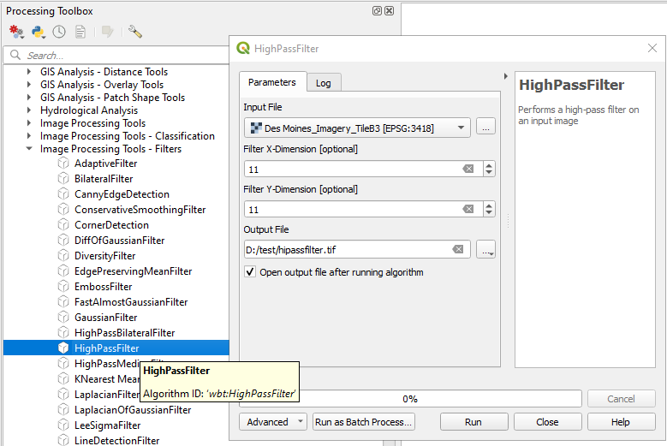
Image Filtering
Go to → Processing Toolbox →Whitebox Tools → image processing tools – filters → Use filters ex: high pass filter → give input image and output path.

Slide 21
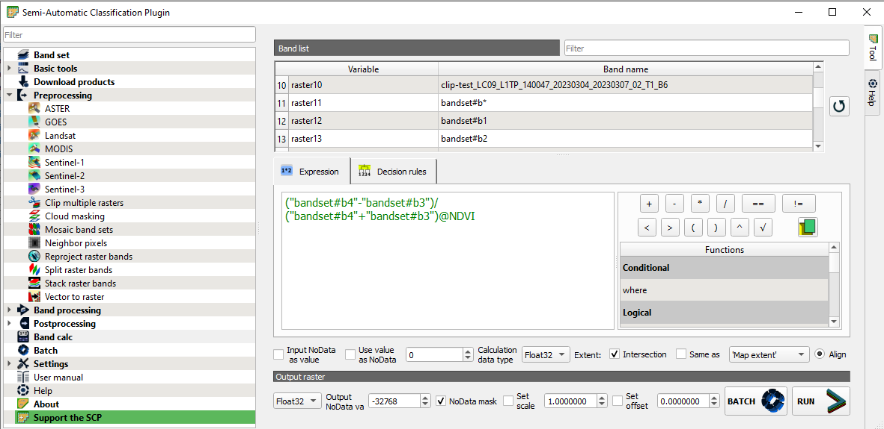
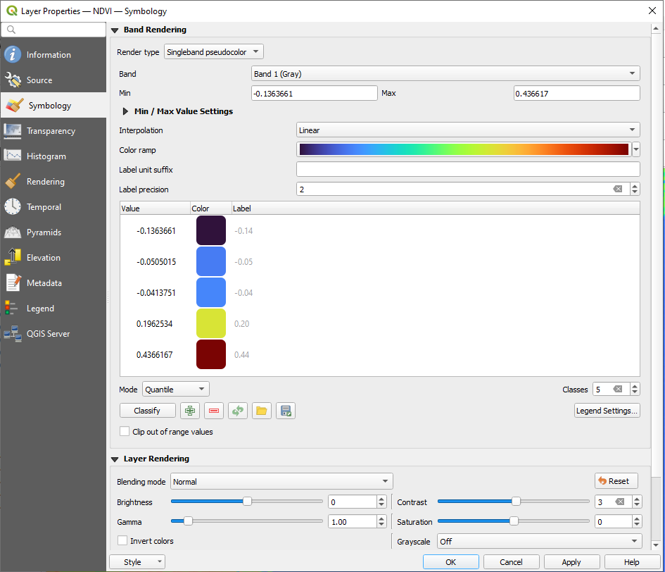
NDVI calculation, Change Symbology and number of classes
Go to SCP →Add bands to band set → go to Band math → write expression [(NIR-RED)/(NIR+Red)]→ Run→ give output path name.
Go to Layer →select the layer and right-click→ Layer properties → Symbology Rendering type: Singleband Pseudocolour→ Colour ramp: select colour → mode: Queantile → Classes: ex:5 →Apply → ok

Slide 22
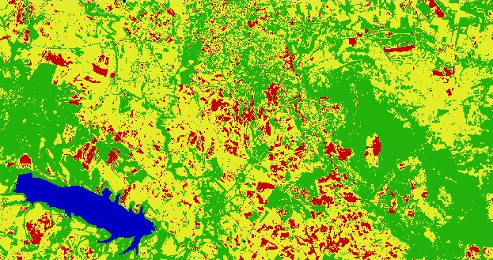
Image Classification
Unsupervised Image Classification

Slide 23
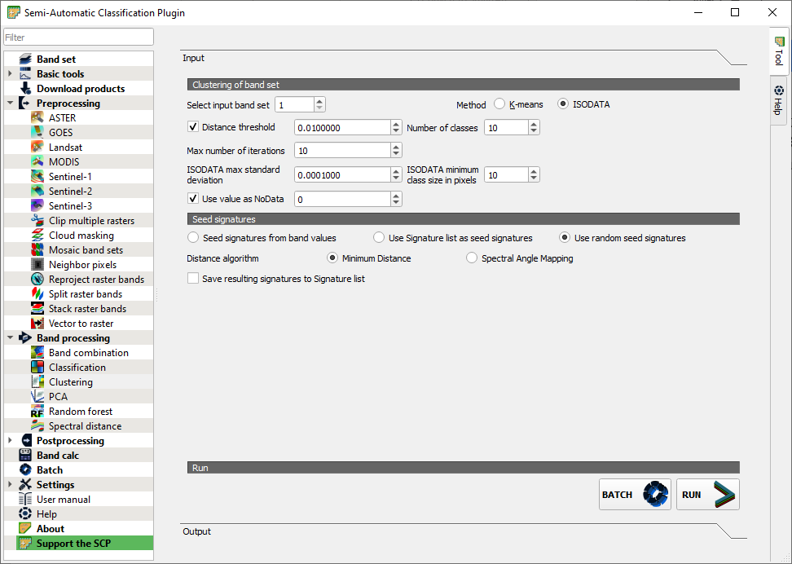
Unsupervised image classification
Open Raster Image in QGIS
Go to SCP→ Band set → Select Multi band image → select our image → select band click on + to make Bandset.
Go to Band processing → Clustering → select input band set: select out band set → Method: K-mean / ISODATA→ Number of classes: as our requirement ex: 5 → check use values as No data: 0 → run → give output path and file name.
Using MapSwipe Tool (plugin), swipe the classified image and check with the original data

Slide 24
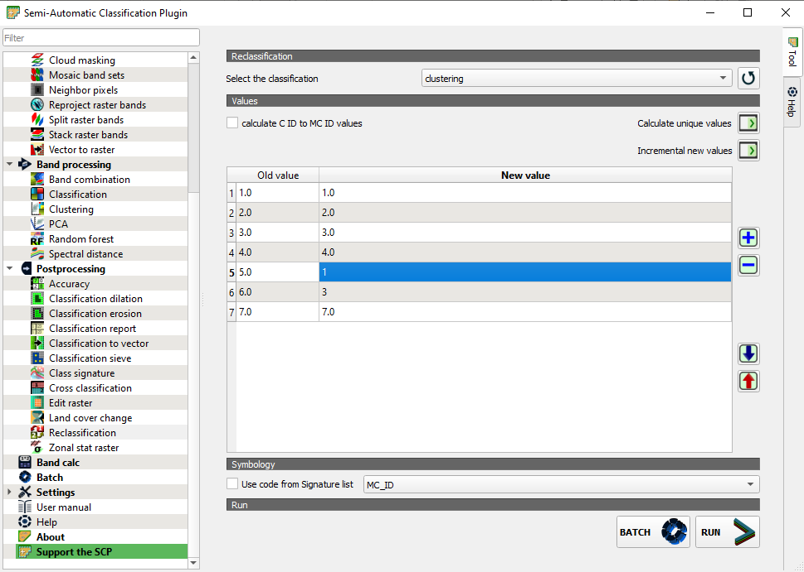
Unsupervised Image Reclassification
Go to SCP → post-processing → Reclassification → Select the classification: select our classified image →click on calculate unique values → class old and new values will appear: make changes in new values ex: old value-02 you can change to 03 in new value like that we can change for required values.→ run → give output path and name.

Slide 25
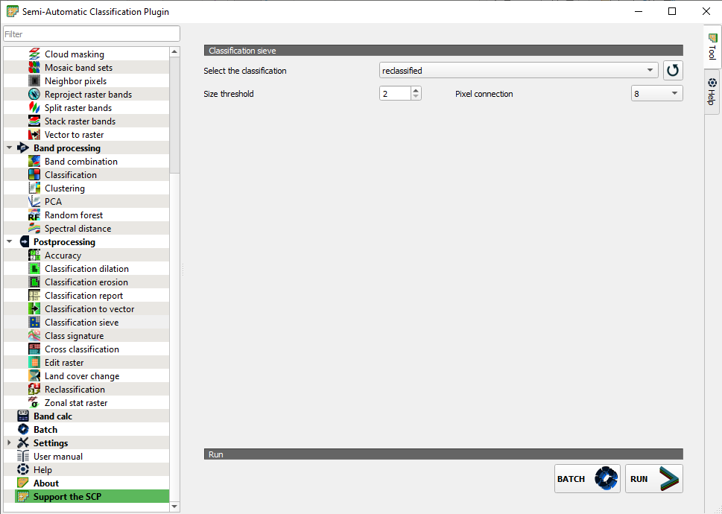
Refinement (removing isolated pixels)
Go to SCP → post-processing → classification sieve → select classification: select our classified/reclassified image →size threshold : 02 → pixel connection: 08 → run → give output path and name.

Slide 26
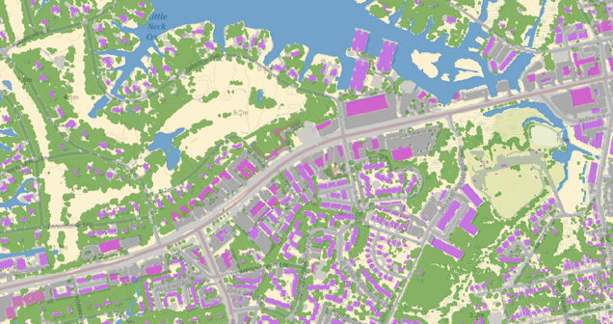
Image Classification
Supervised Image Classification

Slide 27
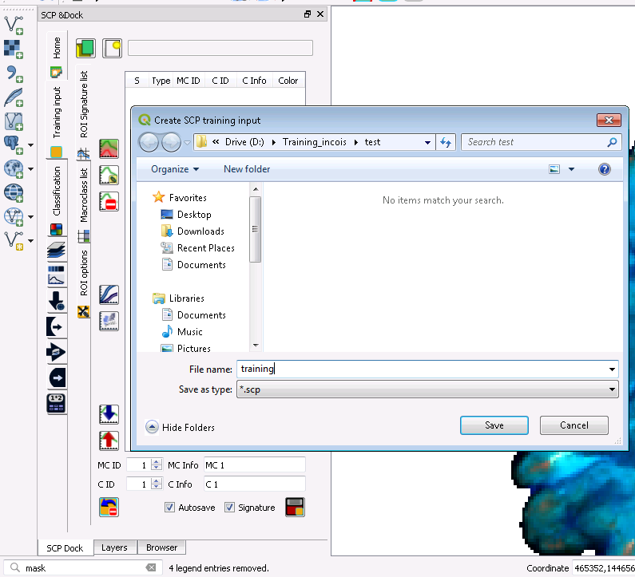
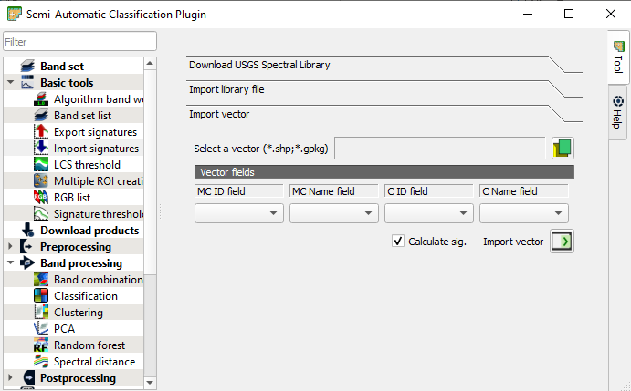
Create the training input file
Go to SCP Dock →Training input → Create SCP training input→ file path and name → Save
2
Import training sample shape file:
Create SCP training input file → go to SCP → Basic tools → Import signatures →select a vector → browse our shapefile → select MC ID field, MC name filed, C ID filed →C name field→ click on import signature.
1
3

Slide 28
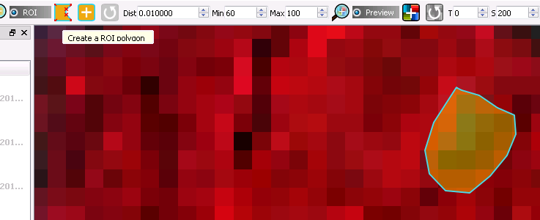
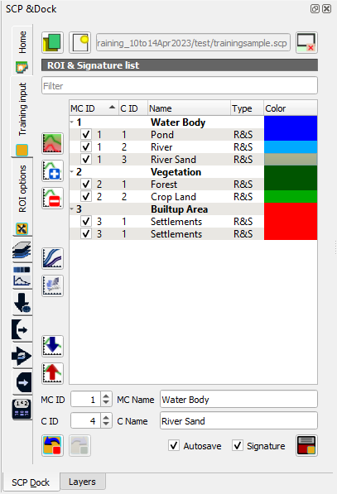
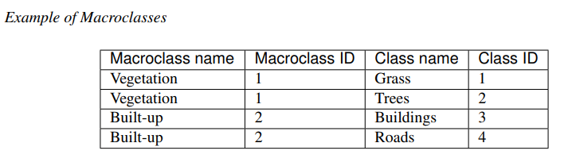
Training sample extraction
Now go to the create ROI polygon and draw a polygon/ active RIO point(if required, change distance value)→give MC ID and
C ID→ Save temporary ROI to training input.
1
2
To refresh ROI (active ROI)click on redo the ROI at the same point
Now click on save temporary ROI to training input
Collect all training classes
Based on class, you have to change MC Id and C ID
Merge signatures, → select 2 or more sign → click on the merge highlighted sign
To delete signature, → select signature → click on delete highlighted items
3
Export signature file as shape file: go to SCP →basic tools → export signatures→ give shape file path and name

Slide 29
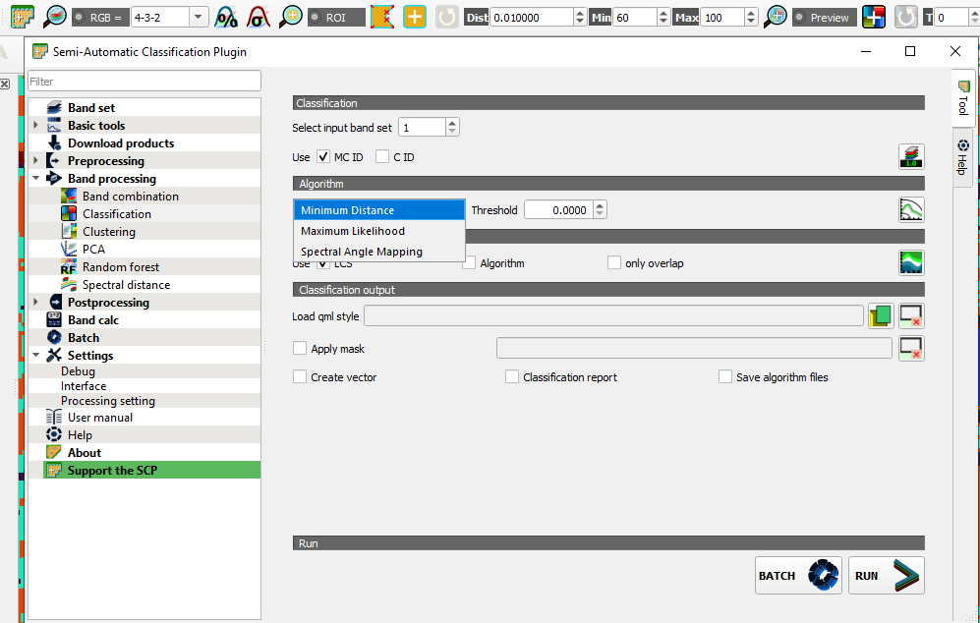
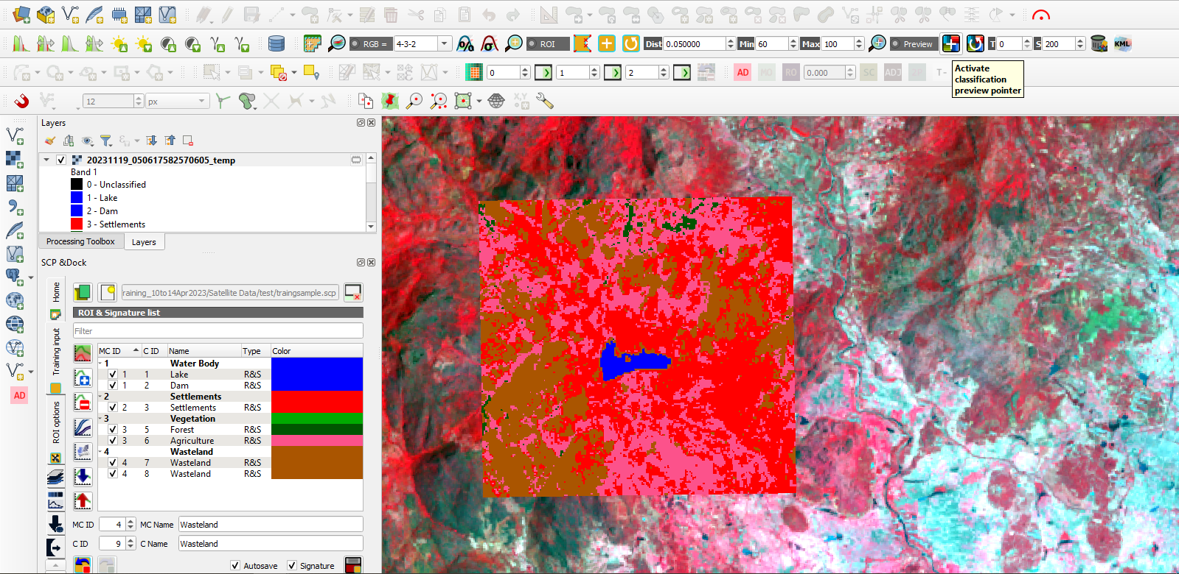
Classification preview
Go to SCP Dock → We have a training sample → go to the SCP working toolbar, → click on the active classification preview pointer → now click on the image → we can see the part of the image is classified.
To change the image classification method, go to SCP→ algorithm: select the new algorithm→ again check the preview. To increase the preview window size change the pixel number: set the preview size.
SCP Working toolbar

Slide 30
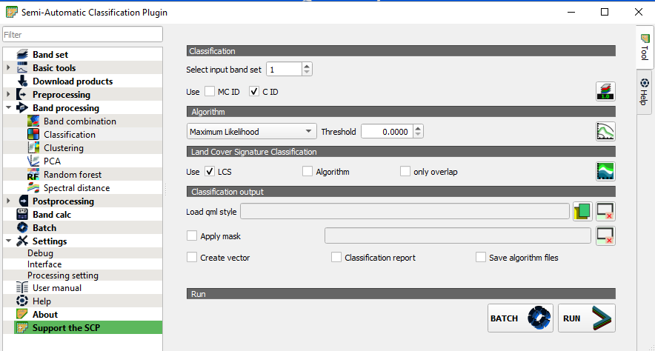
Image classification
Go to SCP Band Processing Classification
Use Micro ID or class ID
Select algorithm Landcover signature classification
Click on run give the path to save the classified image.

Slide 31
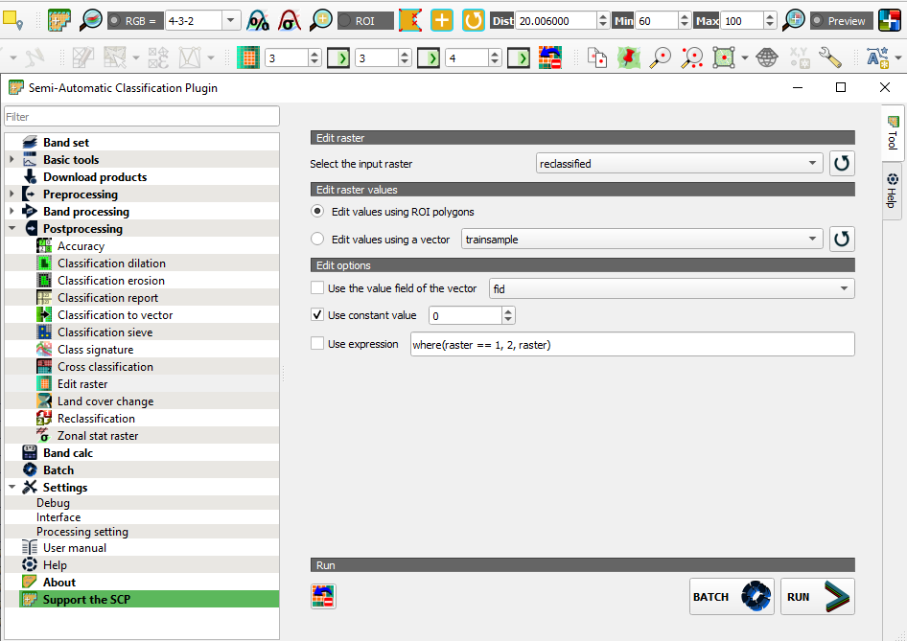
Image Reclassification (Raster Editing Manually)
Go to SCP → Post Processing → Edit Raster→ select input raster: select our classified image → check Edit values using ROI polygons.
Go to SCP tools and draw the area with pixels that we want to move to another class
Go to edit raster tools, enter the class number, → click on Set Values 0/1/2/3 OR check use constant value: give class number → run
We can do undo also(one step)

Slide 32
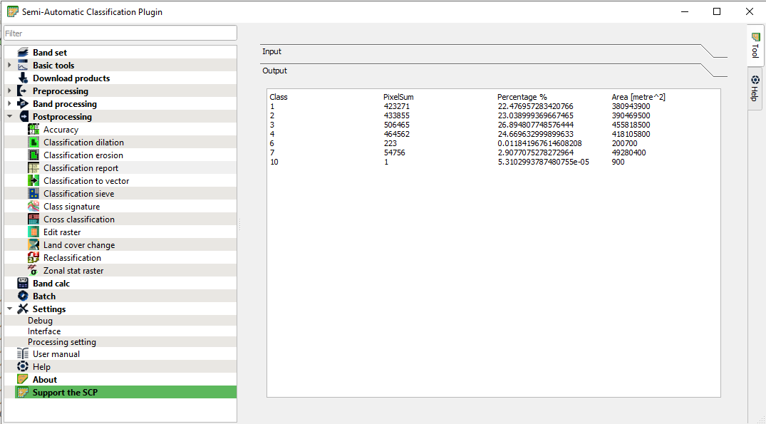
Image classification report
Go to SCP → Post Processing → Classification report→ select classification: select our classified image → run → give output path and name.

Slide 33
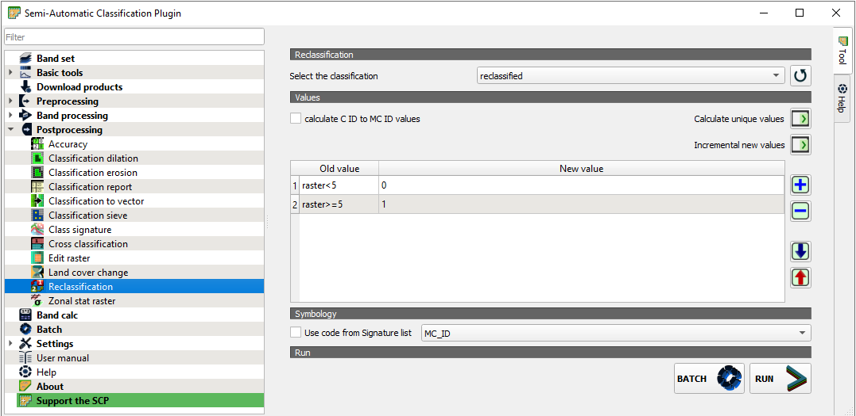
Image reclassification
Go to SCP → Post Processing → reclassification → select the classification: select our classified image →click on add row (add two rows) → write the formula(ex: which gives built-up and non-built-up) → run → give the output path and name.
Remove isolated pixel using classification sieve

Slide 34
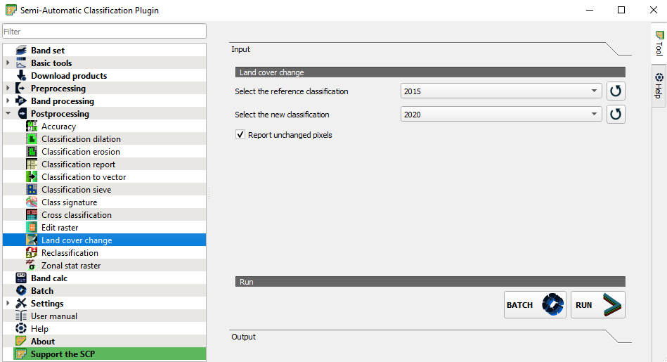
Landcover change
If we have two different time periods landcover mapping images (classified images)
Go to SCP → Post Processing →Land cover change → select the reference classification: ex:2015 and select new classification: ex:2020 → check report unchanged pixels→ run → output path and name.
To extract change if we have a shape file of 2015 lulc. change-2015 lulc gives change (go to post-processing → cross-classification)

Slide 35
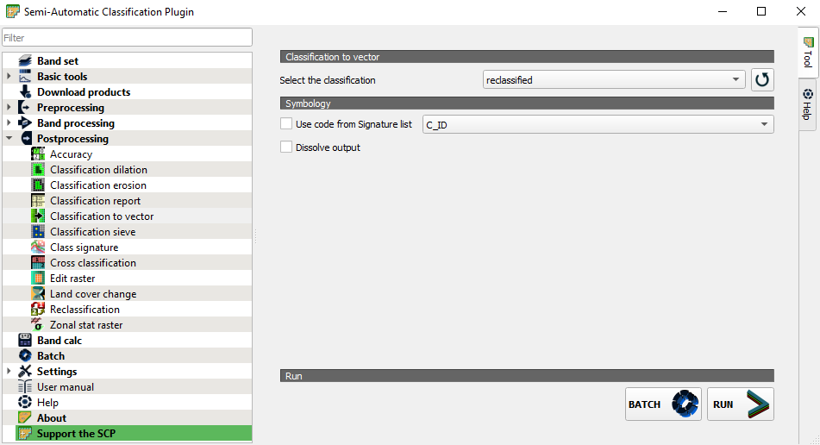
Raster to Vector Conversion
Go to SCP → Post Processing → classification to vector → select the classification: select our classified image → run → give the output path and name.

Slide 36

Thank you

