Slide 1


Shoreline Extraction
H Shiva Kumar
hs.kumar-p@incois.gov.in
ITCOOcean Training Program
on
“Coastal Vulnerability Mapping and Analysis using QGIS”
Organized by
International Training Center for Operational Oceanography (ITCOO)
INCOIS, Hyderabad, India
Nov 25 – 29, 2023

Slide 2
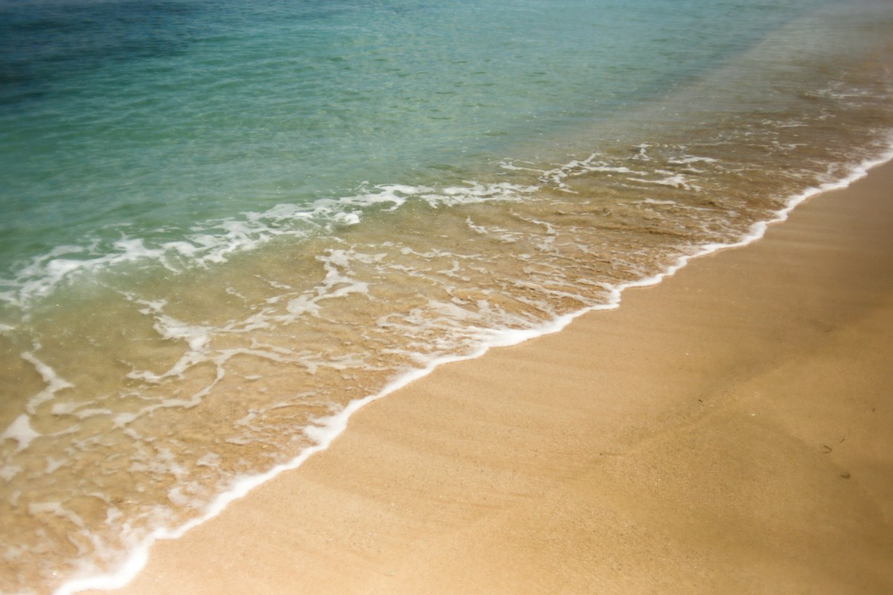

Shoreline
What is shoreline?
The shoreline is the place where a large body of water, like an ocean, lake, or river, meets the land

Slide 3
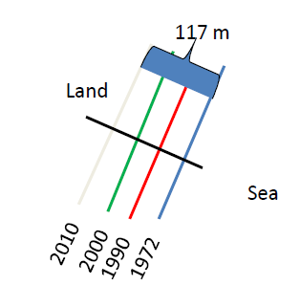
Satellite image Download (Landsat data)
What is shoreline change?
Shoreline change refers to the loss or gain of land area or changes to the landscape on the marine edge.
The shoreline is constantly influenced by sea level variations, climate and ecosystems that occur over a wide range of time scales.
The processes of erosion, accretion, sedimentation, patterns of wind, wave, and sea level rise caused shoreline changes,

Slide 4
Satellite image Download (Landsat data)
Satellite data selection for shoreline extraction
Select Cloud-free satellite data (Jan to March )
Select high tide/low tide duration satellite passes (use wxtide software)
http://www.wxtide32.com/
https://semiautomaticclassificationmanual.readthedocs.io/en/latest/faq.html?fbclid=IwAR2zxlsF4gqQw8D5f8RM3bRiSZFu6hnsDKbnc_B0aPxzLXxePkbbjTd7m2s#can-i-use-the-previous-version-7-of-scp
Useful links:
QGIS Older versions: https://download.qgis.org/downloads/
QGIS Plugins: https://plugins.qgis.org/plugins/
https://www.usgs.gov/landsat-missions/landsat-collection-2
https://www.usgs.gov/landsat-missions/landsat-science-products

Slide 5
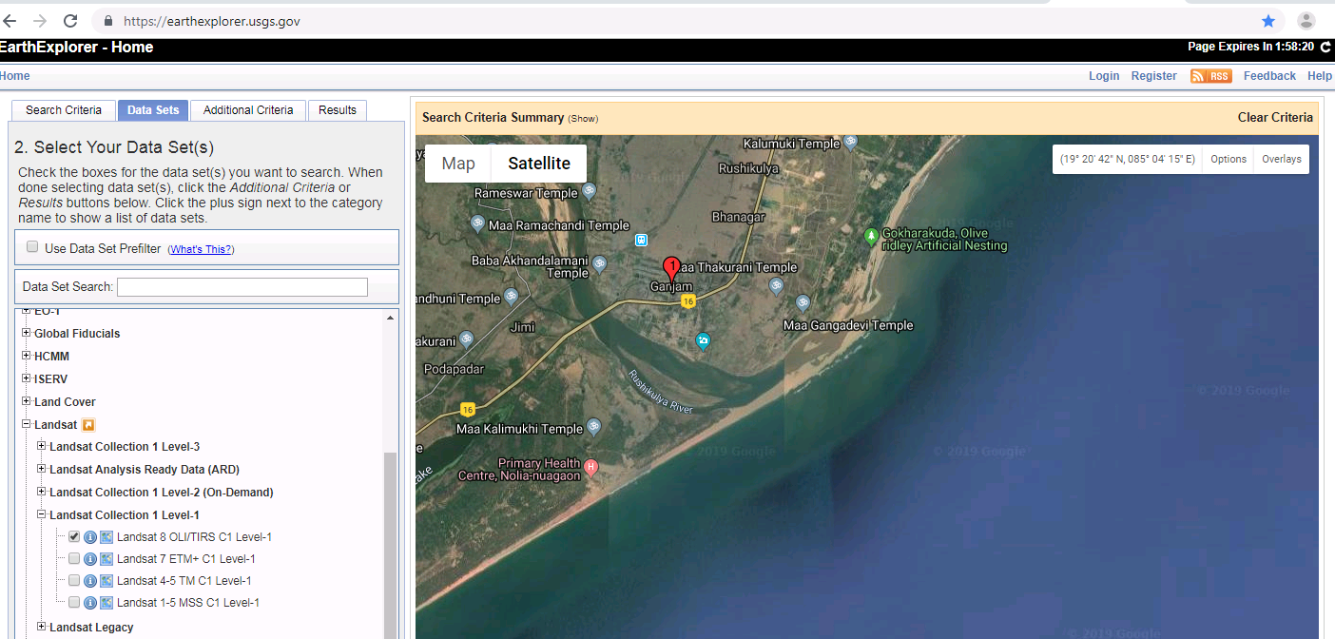
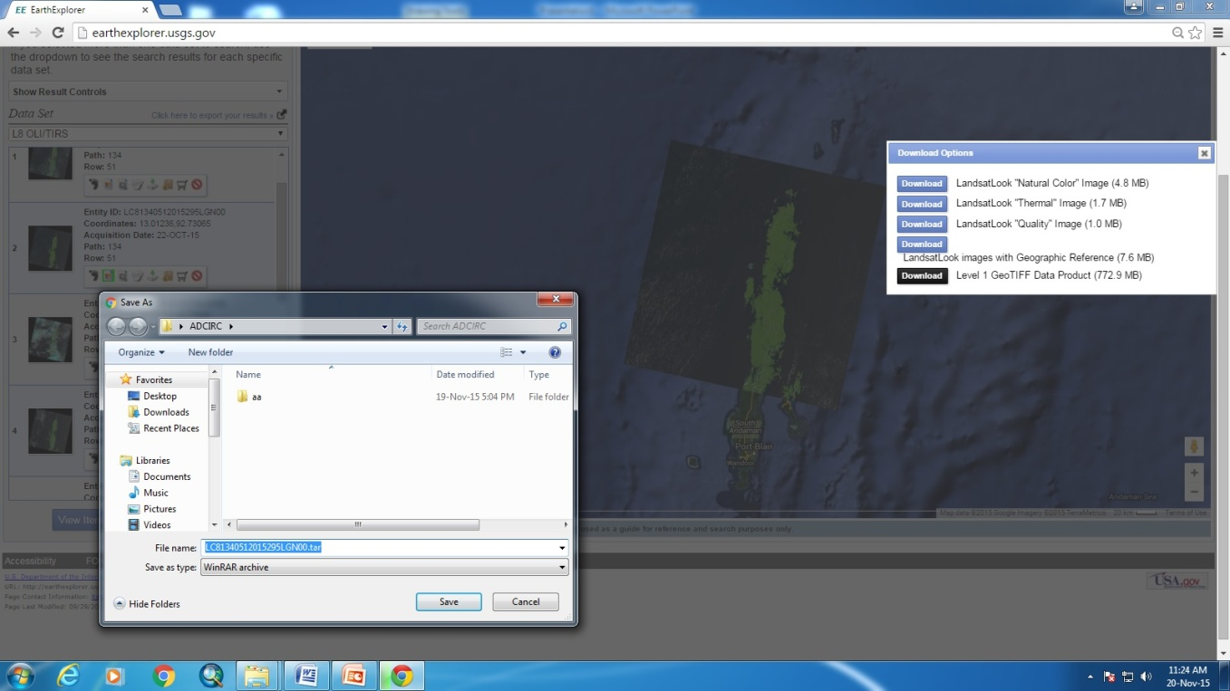
Satellite image Download (Landsat data)
Go to http://earthexplorer.usgs.gov/ and create new user account Login
3
4
7
2
1
5
6
8
Give the path to save data and click on save
Select clear and cloud free data
Download Landsat 8 OLI Level-1 product data set
After download unzip/uncompress the file

Slide 6
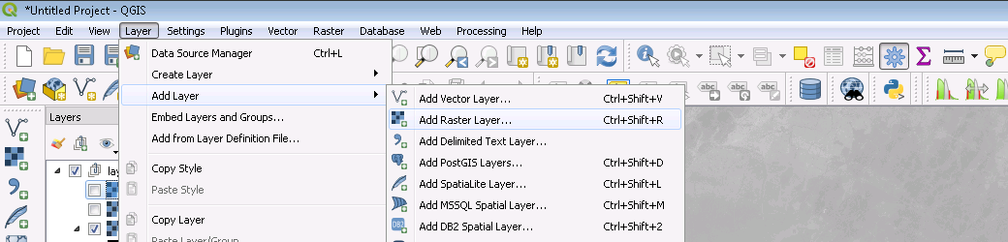
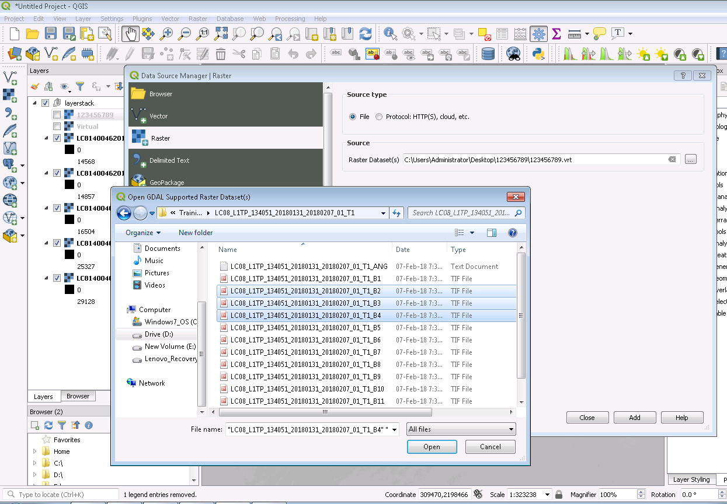
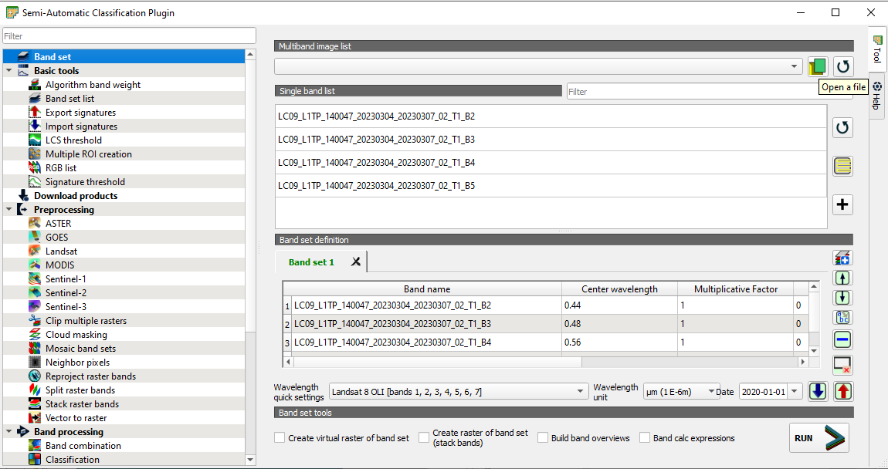
Raster data opening in QGIS:
Method 01
Method 02
1
Go to SCP tool → Band set, → click on Open a file →
browse and select bands → Open
Add bands to band set:
After the above step → click on select all bands →click on
Add band to band set.
2
3
4
a
b
c
d
5
6

Slide 7
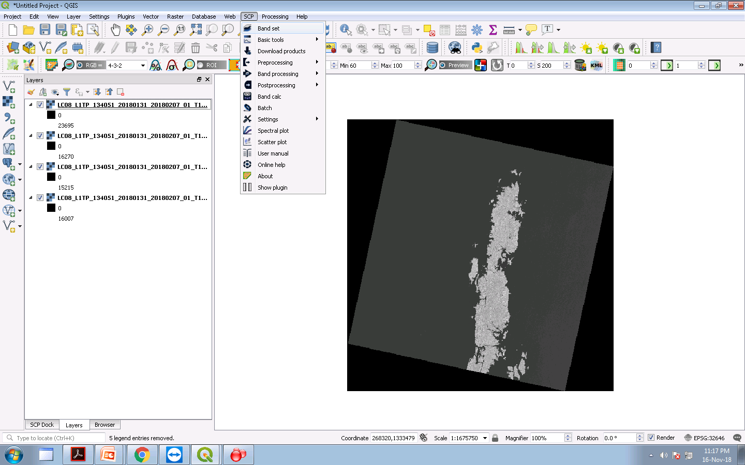
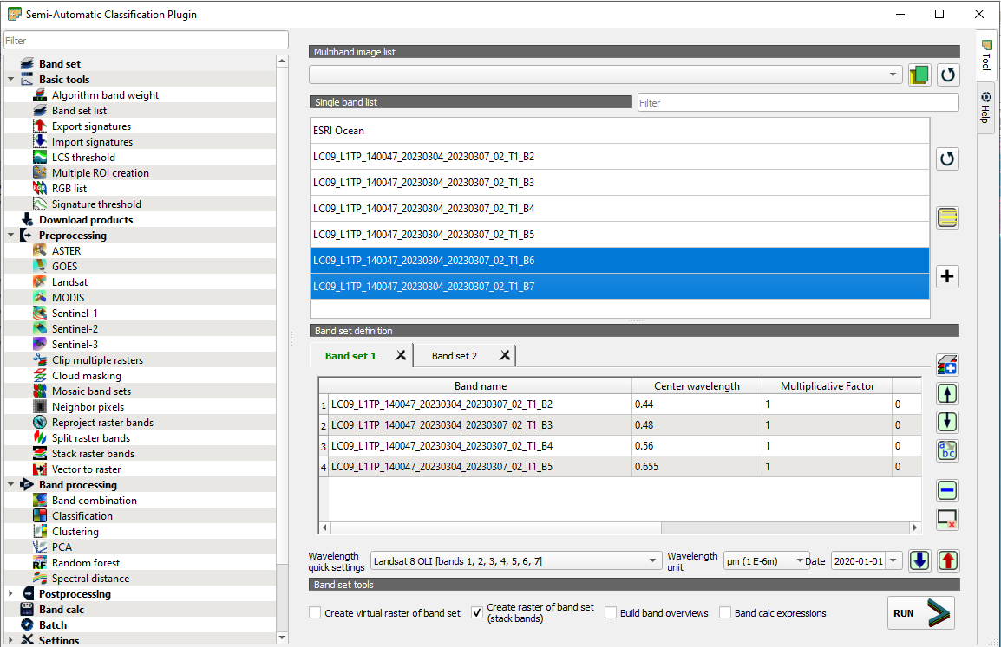
Adding data to multiple band sets:
Go to SCP click on band set SCP plugin window opens.
1
2
In the last slide, one band set is created
If we want to create more band sets and
Add different bands to them.
Create new band set and add bands:
Clock on add a new band set→ and select
that new band to Add bands to that band set
→ select Bands and click on add bands
to band set.
Add or remove bands from the band set:
select bands in the band set to remove
For that band, click on the delete row.
To remove all bands from band set→ click
on reset.
Select band set and select bands in single
band and click on add bands to band set.
If band data not added to QGIS window click on open file Browse the image file
3
4
3
4
Now select the bands which you want
to create band set or select all bands
5
2
1
5
6
6
7
8

Slide 8
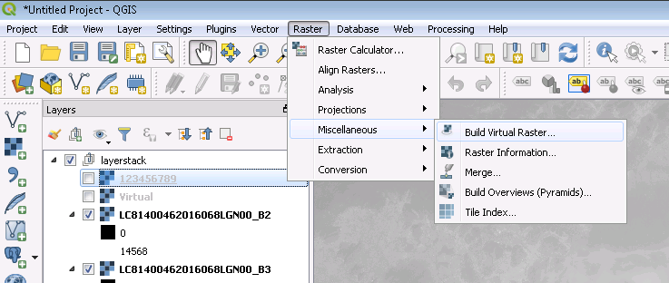
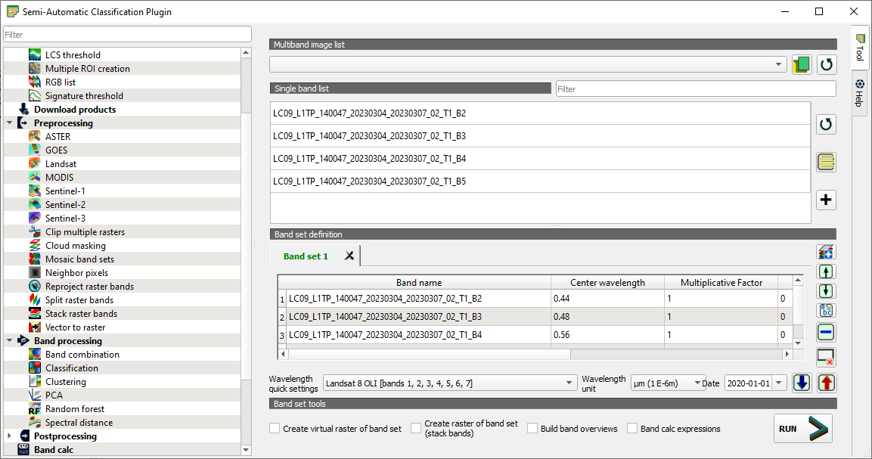
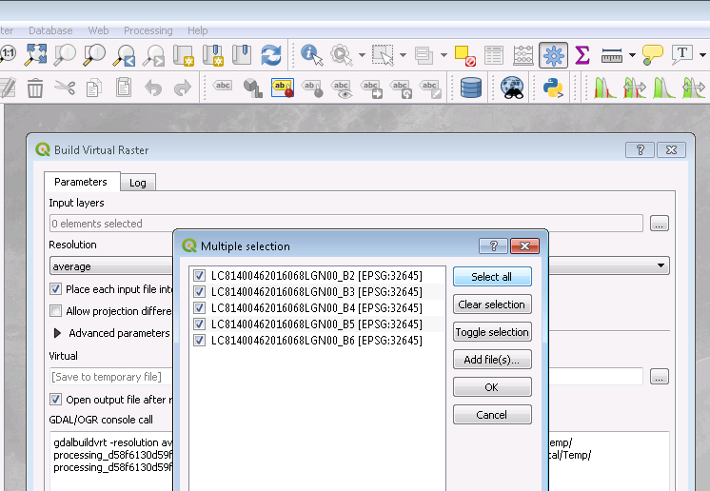
Raster Band Composition/ Layerstack:
Method -01
Method -02
1
Go to SCP tools → bands are added to band set →click on create
raster of band set (stack bands) → click on run → give output folder
or
Go to Preprocessing →Stack Raster Bands→ Select bands set →Run →
Give path and name.
2
3
4
5
6
Go to Raster Miscellaneous → Build Virtual Raster →Input layers, select
our bands →go to Virtual→ save file → give the name and path → run

Slide 9
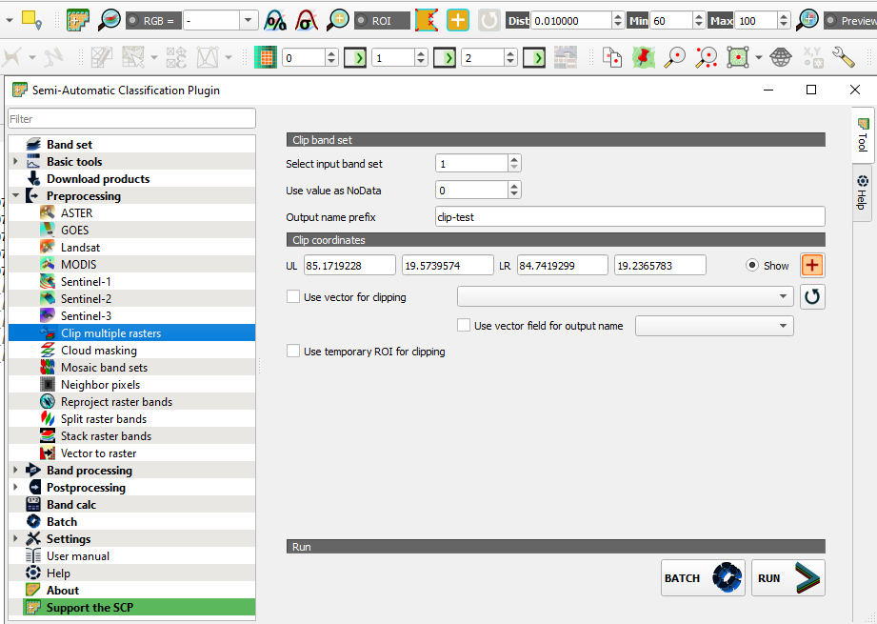
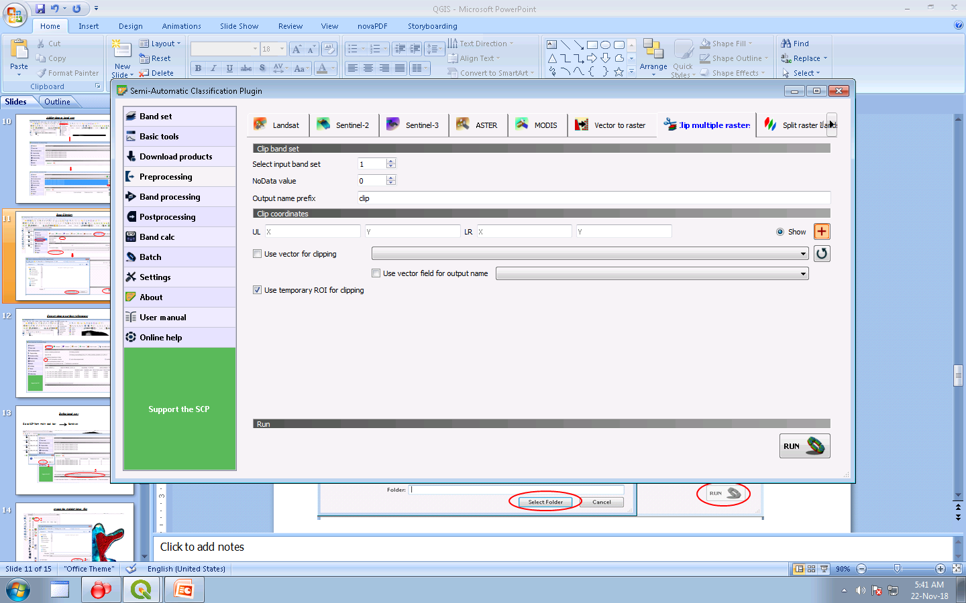
Image Clipping
Go to SCP → preprocessing →Clip multiple rasters → Select band set → Use value as no data: 0 → O/P name: give any name →to select RIO click on set an area in the map, → put points on the map, → click on the run → give output folder name.
Select ROI using a vector file:
If you have an ROI vector file we can use that file to clip the raster image → open the vector file in map window →just check the use vector for clipping: select our vector file → and run give o/p path.
Select ROI using temporary ROI:
Using the ROI tool in the map window draw ROI on the map/ image. Now in SCP Check use temporary ROI for clipping→ run → give output path.
2
3
5
1
6

Slide 10
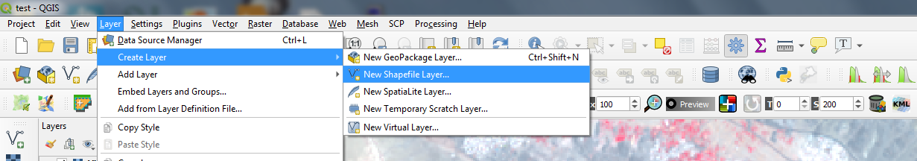
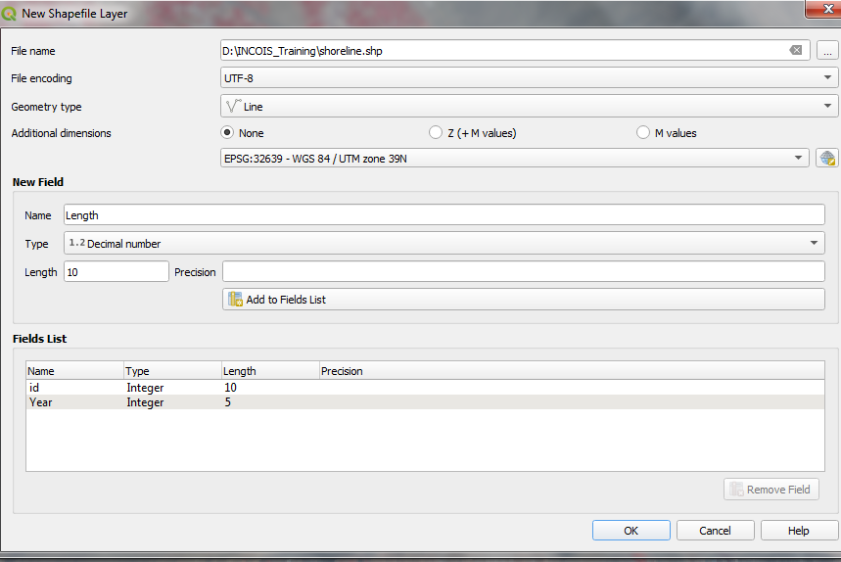
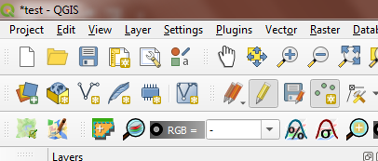
Line Shapefile creation:
Go to layer Create Layer New shapefile Layer
1
2
3
4
5
Direct click on create new shape file icon
6
7
8
9
10

Slide 11
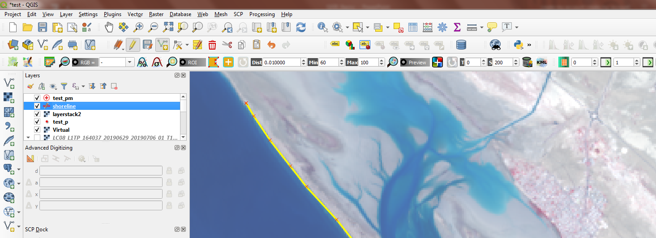
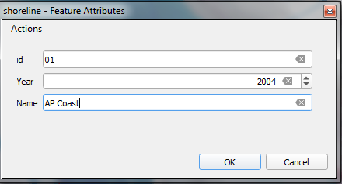
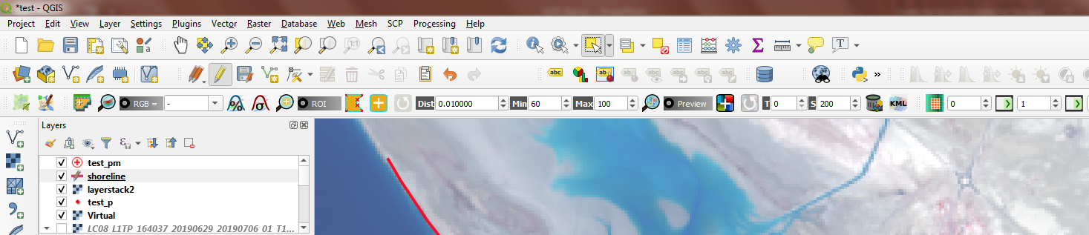
Line Shapefile Editing :
Select line shape file
Click on Toggle editing add line feature draw a line on image
3
2
1
4
5
Draw a line and to complete line right click on mouse
6
To save edited data click on save layer edits.
To stop editing click on Toggle editing
8
7

Slide 12
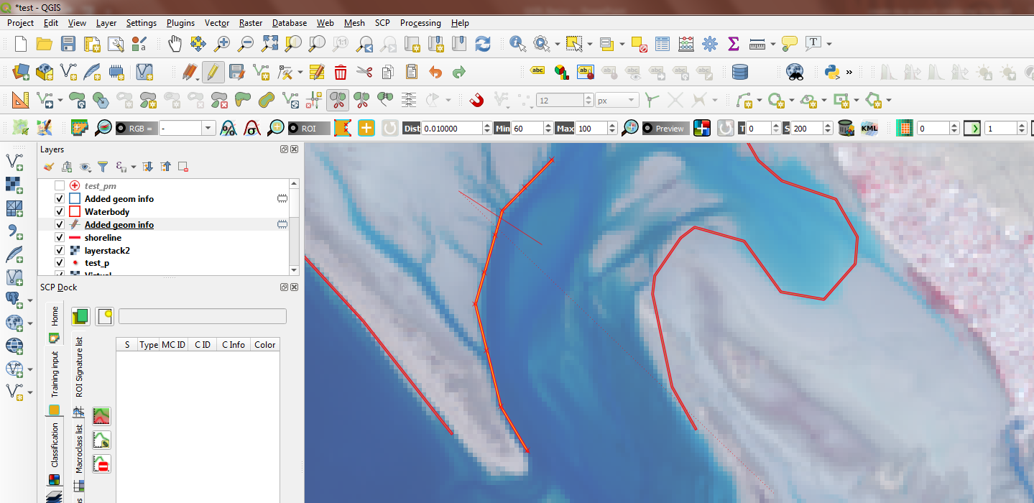
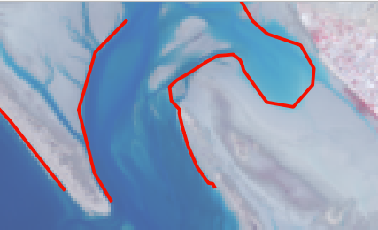
Contin…….
Split line feature :
Select the line which you want to split using select features by area or a single click
Click on split features draw a line where you want to split and right-click to complete the line
Reshape Line feature:
Select the line which you want to split using select features by area or a single click
Click on the reshape feature draw a line where you want to split and right-click to complete the line
Note: Drawing a line in reshape the feature line first point and the last point should touch the line feature
1
Reshape features
Split features
Split line
Before reshape
After reshape

Slide 13
Shoreline extraction
Method: 02
NDWI Calculation:
NDWI= (Green-NIR)/(Green + NIR)
Convert to binary: NDWI>0.01 /-0.03
Convert binary to shapefile
Convert raster to Vector
Smooth line and edit

Slide 14
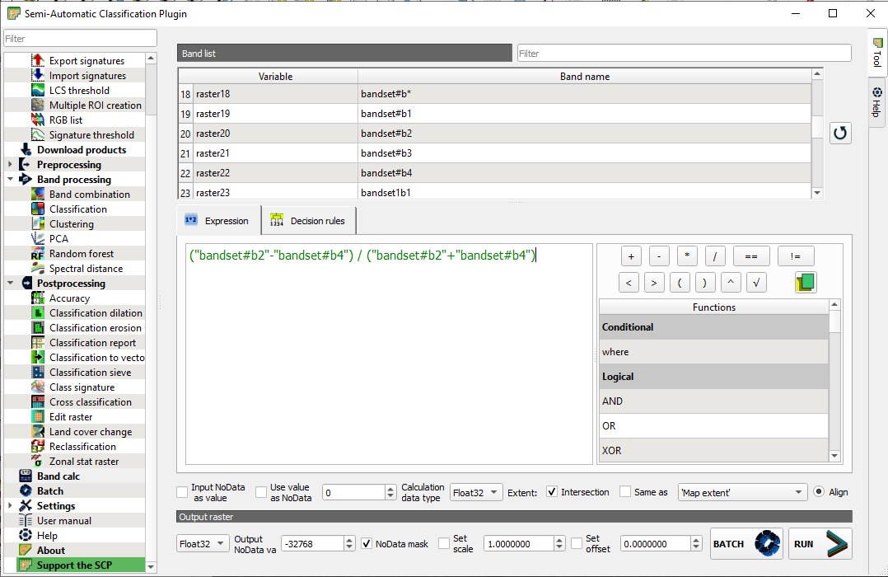
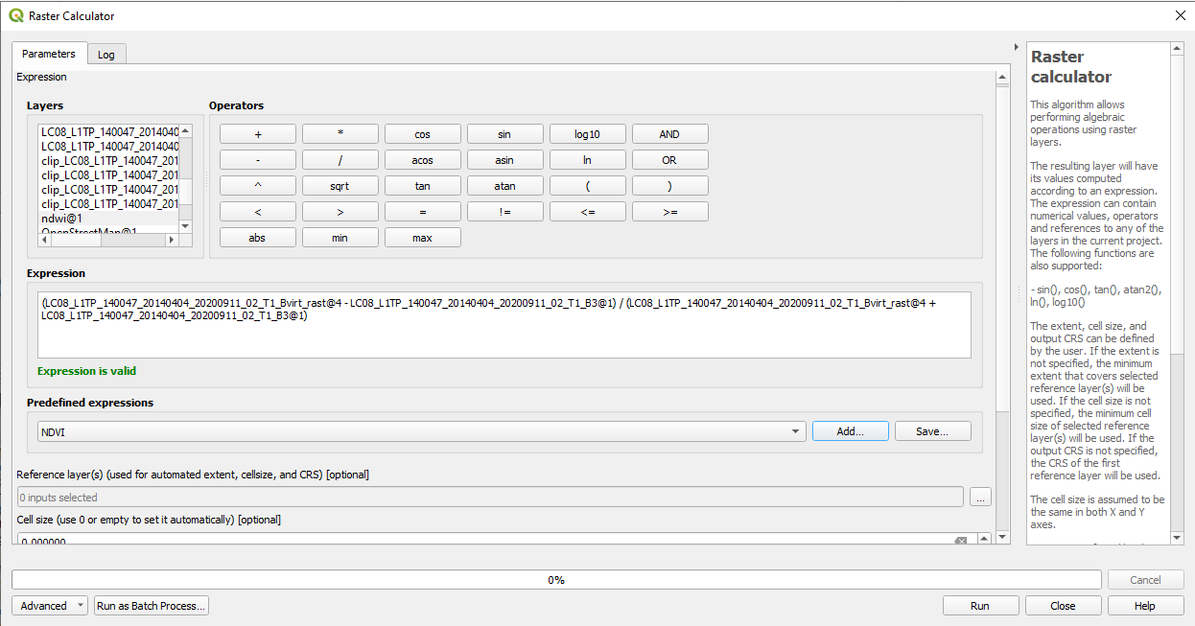
Shoreline extraction
NDWI Calculation:
Method: 01
Go to SCP → post-processing → Band calc → write NDWI formula
NDWI formula = (Green-NIR)/(Green + NIR) → click on Run → Give name and output path.
Method:02
Go to processing toolbox → Raster Analysis → Raster Calculator → Write NDWI formula or go to NDVI Click on Add → select green band at Red and NIR at NIR → ok → Run.

Slide 15
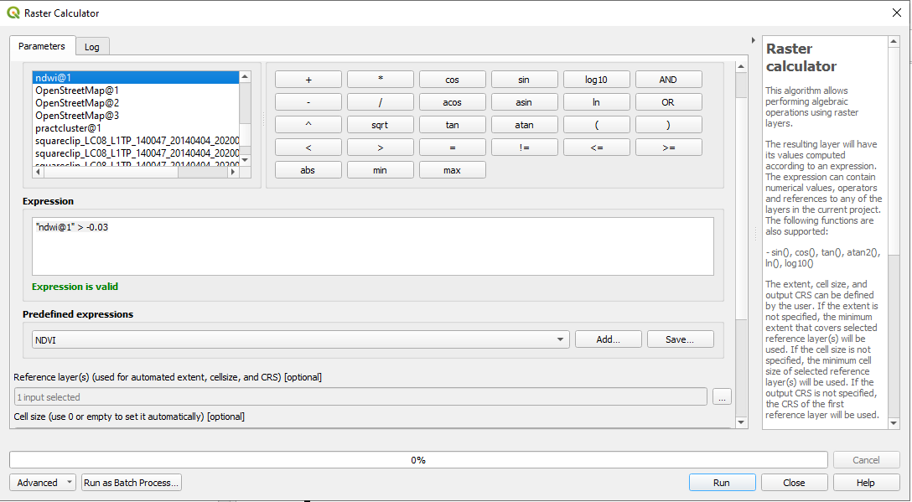
Shoreline extraction
Now set the water and land NDWI range → and convert it into binary(0,1) data.
Go to processing toolbox → Raster Analysis → Raster Calculator → Write threshold (ex: "ndwi@1" > -0.03) → Reference → select our layer CRS → give output Name and path → Run

Slide 16
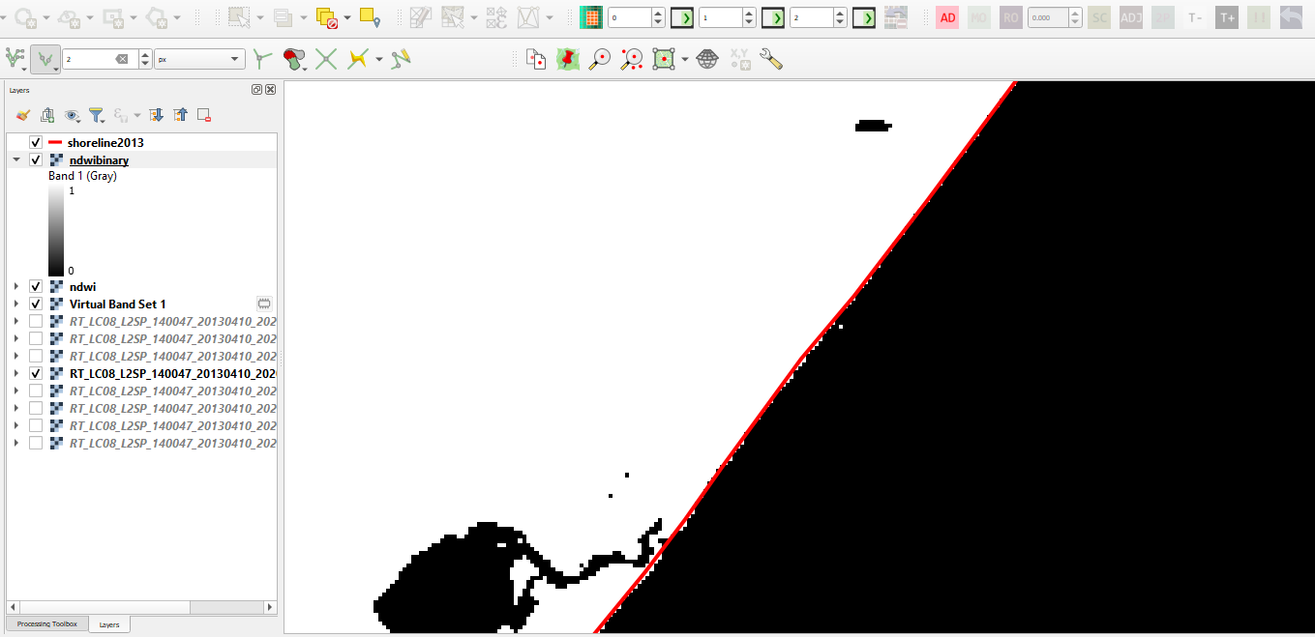
Shoreline extraction
NDWI to Binary conversion output. Here zero is the ocean (water body) part and one is the land part
Convert Raster to Vector (polygon)
Remove Land part
Covert polygon to line
Smooth line

Slide 17
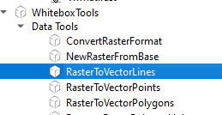
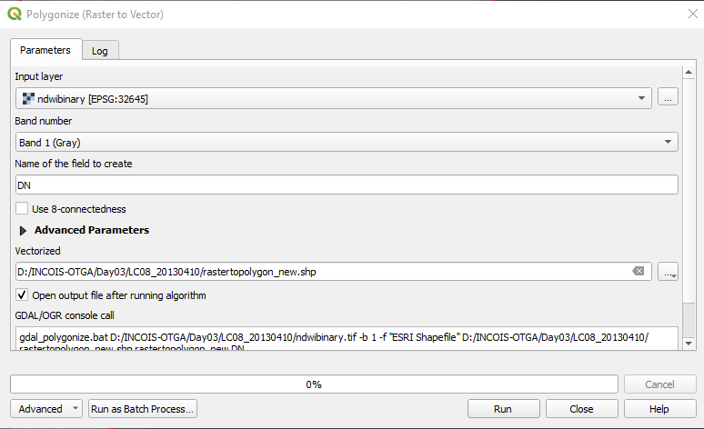
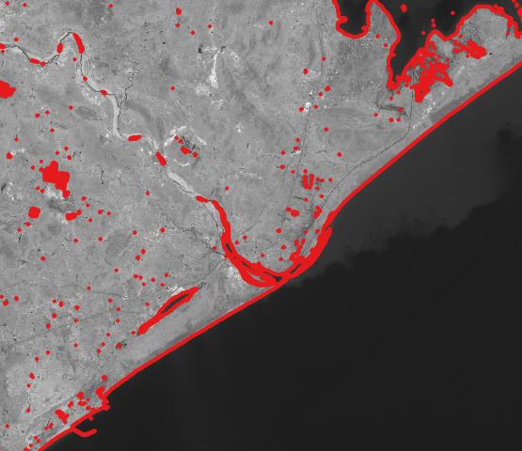
Shoreline extraction
Convert from binary to polygon: Go to Raster → Conversion→ Polygonise (Raster to Vector)→ input select our ndwibinary file, give output path and name → run
Or
Directly convert raster to line feature: Go to processing toolbox → whitebox tools → data tools → RaterToVectorLines
Output of the raster to vector conversion

Slide 18
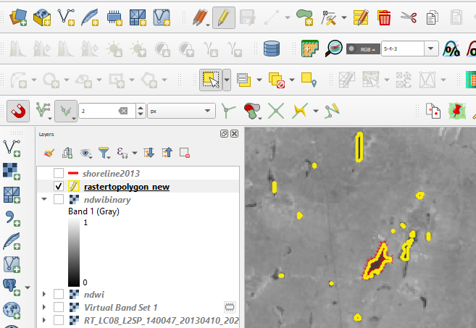
Shoreline extraction
Now select rastertovector polygon file → click on toggle editing → select the and part polygons and delete, keeping only ocean part polygons→ click on save→ click on toggle edit to stop edit.

Slide 19
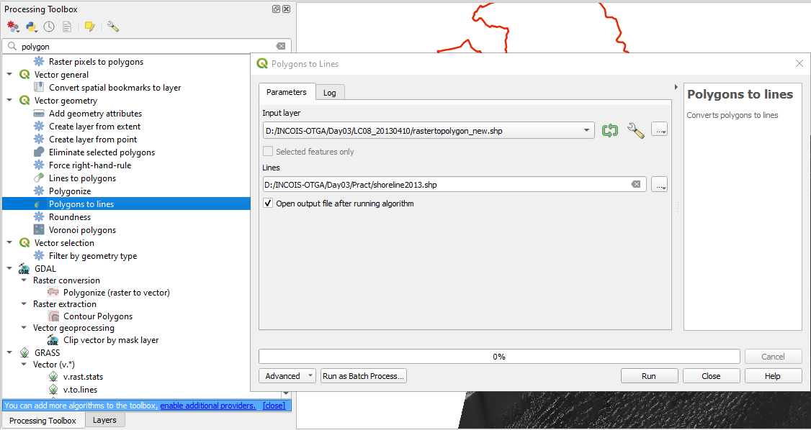
Shoreline extraction
Now convert the polygon file to a line file: Go to processing toolbox → Vector geometry → select input fille (raster to vector) → give path and output → run

Slide 20
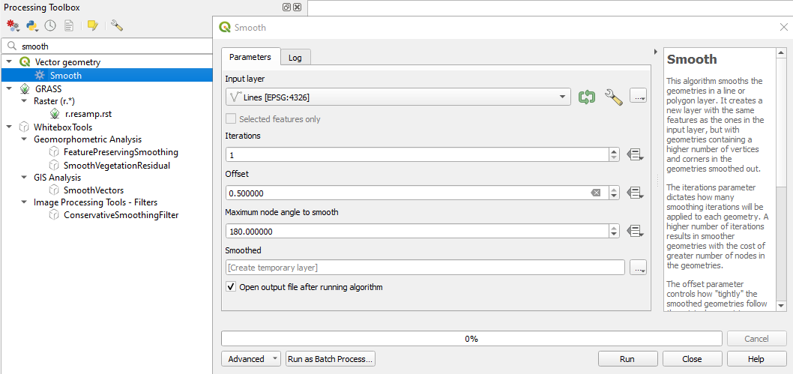
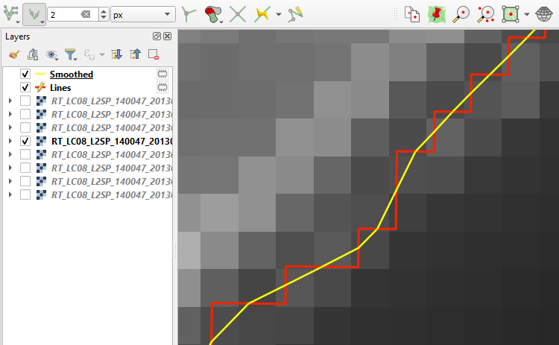
Shoreline extraction
Line smooth: Go to processing toolbox → Vector geometry → smooth → give input our line (shore line) feature → give offset 0.25 or 0.5 (see the changes) → give output path and name → run
Line smooth Output

Slide 21

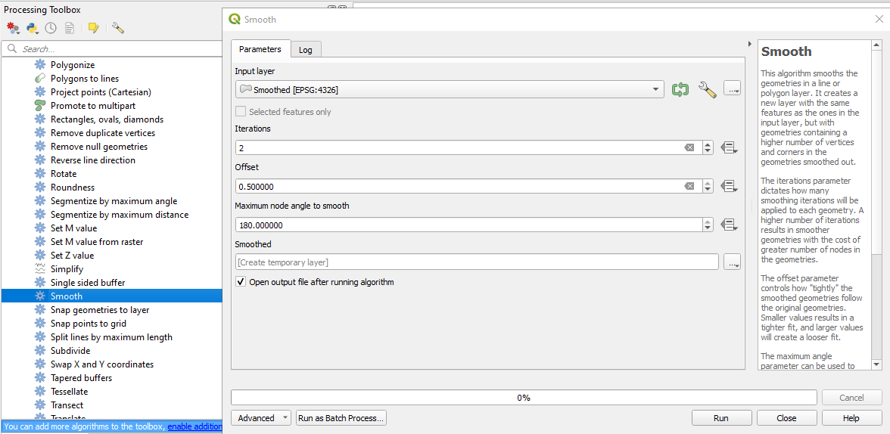
Shoreline extraction
Raster to vector conversion:
Go to Processing Toolbox → Whitebox tools → Data tools → Raster to VectorLine/ Raster to VectorPolygon → Give input file and output name and path → run.
(if you covet to polygon, convert to line. Whitebox tools→ data tools→polygonstolines)
Smooth Line:
Go to processing tools → Vector Geometry → Smooth
Give input layer → iterations ex:5→ offset ex: 0.50
Max node angle to smooth ex: 180 → give output
Path and Name→ Run.
Thank You

